Slide 1
Properties of the New Boson
M. Antonelli
LNF-INFN

Slide 2
Outline
Introduction
Properties:
  Mass measurements
  Spin-Parity determination
  Couplings from signal strengths μ=[σ×BR]/[σ×BR]_{SM}
  Differential cross-sections in γγ final state
Perspectives at future colliders
Conclusions

Slide 3
Higgs boson production at LHC
Loop – Top coupling
BSM contribution ?
Tree level W(/Z) V coupling
Tree level top coupling
Tree level W coupling
Tree level Z coupling
Main production mode: ggH
Access to top (direct and Loop), W and Z couplings via production cross section

Slide 4
Higgs boson production at LHC
8 TeV
M_{H}(125 GeV) | σ(fb) | δ(th)_{TOT} | δ(th)_{QCD-Scale} | δ(th)_{PDF+αs} | δσ/δM(.5GeV)
ggH | 19.5 x 10³ | 11% | 8% | 7% | 0.8%
VBF | 1.58 x 10³ | 3% | 0.2% | 3% | 0.4%
WH | 697 | 4% | 0.5% | 4% | 1.3%
ZH | 394 | 5% | 1.5% | 4% | 1.3%
ttH | 130 | 11% | 7% | 8% | 1.9%
Cross-sections are LARGE: LHC is the first Higgs Factory → Produced H~600k/Exp.
Theory systematics more relevant for ggH and ttH - Mass dependency very weak

Slide 5
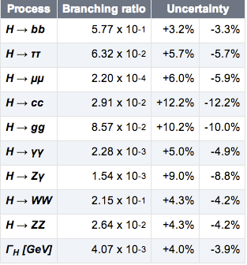
Higgs boson decay at LHC
M_{H}=125 GeV
Experimentally accessible:
  bb, ττ, WW*, ZZ*, γγ, Zγ, μμ
Γ_{H}(125) ~4 MeV NO direct measure at LHC
Mass dependency:
  δBR(bb)/0.5 GeV → 1%
  δBR(WW*)/0.5 GeV → 4%
  δBR(ZZ*)/0.5 GeV → 4%

Slide 6
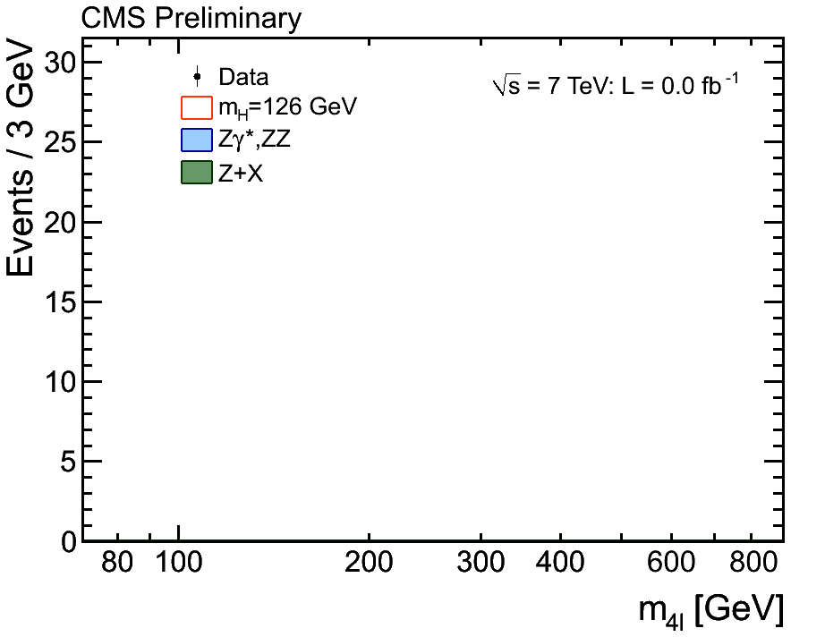

Introduction
1 year ago ATLAS and CMS Collaborations announced the discovery of a NEW neutral Boson supported by D0 and CDF results
Since then the ATLAS, CMS have accumulated statistics…..

Slide 7
Introduction
1 year ago ATLAS and CMS Collaborations announced the discovery of a NEW neutral Boson supported by D0 and CDF results
Since then the ATLAS, CMS, CDF and D0 Collaborations focused on two questions:
  Is this new boson responsible for the EW symmetry breaking - BEH mechanism - providing masses to Fermions and Bosons: “the SM Higgs boson” ?
  Can we find signs of Physics Beyond the SM (BSM) studying its properties ?
Addressed experimentally by properties measurement in next slides ...

Slide 8
Mass Measurements
From γγ and ZZ*(4l) mass spectra
  ATLAS: M_{H} = 125.5 ± 0.2_{stat} ± 0.6_{sys} GeV CMS: M_{H} = 125.7 ± 0.3_{stat} ± 0.3_{sys} GeV
ATLAS: M_{H} = 124.3 ± 0.6_{stat} ± 0.4_{sys} GeV
CMS: M_{H} = 125.8 ± 0.5_{stat} ± 0.2_{sys} GeV
ATLAS: M_{H} = 126.8 ± 0.2_{stat} ± 0.7_{sys} GeV
CMS: M_{H} = 125.4 ± 0.5_{stat} ± 0.6_{sys} GeV

Slide 9
Mass Measurement
  Measured from γγ and ZZ*(4l) mass spectra: needed to predict σ×BR
  ATLAS: M_{H} = 125.5 ± 0.2_{stat} ± 0.6_{sys} GeV CMS: M_{H} = 125.7 ± 0.3_{stat} ± 0.3_{sys} GeV
  From γγ: Γ_{H}<6.9 GeV at 95% CL (direct)
  *Independent of signal strengths: used by ATLAS and CMS coupling/spin analyses
New

Slide 10
Spin-Parity Determination:
Experimental approach:
Use observables that are sensitive to Spin and Parity of the New Boson independent of the coupling strengths
Several alternative specific models: 0⁻, 1⁺, 1⁻, 2⁺ tested against the SM Higgs 0⁺ hypothesis
On-shell X(J=1) → γγ by Landau-Yang theorem

Slide 11
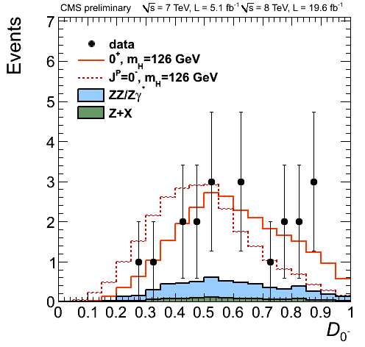
Spin-Parity Determination
Analyzed channels:
H→ γγ decay angle cos(θ*) in Collins-Soper frame sensitive to J
H → WW* → lνlν Several variables sensitive to J^{P}
  Δφ_{l l} , M_{l l} , ..
  Combined with Boosted-Decision-Tree (BDT)
H → ZZ* →4l: Full final state reconstruction sensitive to J^{P}
  2 masses (M_{Z1},M_{Z2}) and 5 angles
  Combined with BDT or Matrix-Element-based discriminant D_{JP}

Slide 12
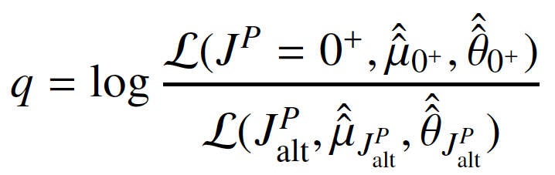
Test of 0⁺ vs 0⁻
ZZ*→4l channel used by CMS and ATLAS:
ATLAS:
0⁻ Excluded @ 97.8% CL (exp. 99.6%)
CMS:
0⁻ Excluded @ 99.8% CL (exp. 99.5%)
Compatible with SM 0⁺
Test Statistic:
2q =

Slide 13
Beyond 2 hypotheses Test: 0⁺ vs 0⁻
CMS investigated sensitivity to different CP Amplitudes in ZZ* channel
SM Higgs at LO corresponds to a₁=1 and a₂=a₃=0
A₃= CP odd Amplitude
  Fit for f_{a3} = |A₃|² / (|A₁|² + |A₃|² ): check the presence of a 0⁻ component (assuming a₂=0) - impact of interference very small on used observables
  CMS: f_{a3} = 0.00 ^{+ 0.23} _{– 0.00}
  f_{a3} < 0.56 at 95% CL (exp. 0.76)
95% CL

Slide 14
Test of 0⁺ vs 2⁺
Graviton inspired model with minimal couplings to SM particles
It can be produced via gg or qq annihilation:
f_{qq} = faction of qq/gg produced signals
(In minimal model 2⁺_{m} at LO in QCD expected f_{qq}=4%)
ATLAS: Combined: γγ + ZZ*→ 4l + WW*→νl νl
2⁺ (100% qq) Excluded at >99.9% CL (exp. >99.9%)
2⁺ (100% gg) Excluded at >99.9% CL (exp. 99.9%)
CMS: Combined ZZ*→ 4l + WW*→νl νl
2⁺ (100% gg) Excluded at 99.4% CL (exp. 98.8%)
Both experiments: Compatible with SM 0⁺
2q =

Slide 15
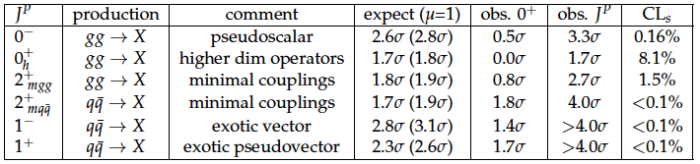
Spin-Parity ATLAS - CMS Overview
ATLAS and CMS: “bosonic” decay modes
Strongly favor J^{P} = 0⁺ SM quantum numbers
All alternative J^{P} models tested:
Excluded @ >95% CL
CMS ZZ*(4l)

Slide 16
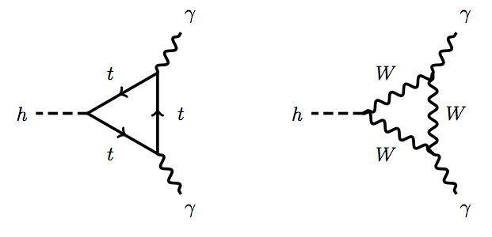
NEW Boson Couplings
  Crucial TEST of SM BEH mechanism → g_{F} α m_{F} and g_{W,Z,H} α M²_{W,Z,H}
SM couplings tested introducing coupling scale factors κ → g_{i} = g_{i}SM × κ_{i}
  SM Tree-Level Amplitudes:
    Γ_{ff} α (κ_{f} × m_{f} /v)² α κ_{f}² × Γ_{ff}SM (v= 246 GeV from G_{F})
    Γ_{WW} α (κ_{W} × M_{W}²/v)² α κ_{W}² × Γ_{WW}SM
    Γ_{ZZ} α (κ_{Z} × M_{Z}² /v)² α κ_{Z}² × Γ_{ZZ}SM
  SM Loop-level: best place to look for physics Beyond the Standard Mode
    Γ_{γγ} α |1.28 κ_{W} – 0.28 κ_{t}|² × ΓSM_{γγ} → Wt interference
    Γ_{gg,} Γ_{γZ, ...}
Theory errors for SM Higgs boson:
  σ_{Η} ~ (11-5)% larger in ggH and ttH - BR_{H} ~ (3-6%)
*Mass dependency small: Max ~ 4%/0.5 GeV for Γ_{ZZ}

Slide 17

The Couplings Test
Follow recommendations from LHC Higgs xs-wg: arXiv1307.1347 (YR3) assuming:
  1 resonance + Zero-Width Approx. + SM Lagrangian Tensor Structure (J^{P}=0⁺)
Approach suitable to test SM predictions exploiting correlations between production (gg, VBF, VH, ttH) and decay modes with current precision
e.g., measured yield ZH→Zbb parameterized as:
  μ(ZH→Zbb) = [σ_{ZH}xBR(H→bb)]/[σ_{ZH}xBR(H→bb)]_{SM} = (κ_{Z}² × κ_{b}² )/κ_{H}²
SM Higgs boson → All μ and κ compatible with 1
Loop scaling factors κ_{γ} , κ_{g} can be :
  Expressed as a function of SM couplings scale factors: κ_{γ}(κ_{W},κ_{t})
  Treated as free parameter to test BSM contributions
Γ_{H} need assumptions: ratios, relationships κ_{H}=κ_{H}(κ_{b}, κ_{W},...), ...

Slide 18
The signal Strength μ
Combined μ → Best accuracy but no strong physics motivation:
  ATLAS (γγ, WW* and ZZ*) μ = (1.33 ± 0.20) (1.23±0.18 including bb and ττ)
  CMS (γγ, ττ, bb, WW* and ZZ*) μ = (0.80 ± 0.14)
  TEVATRON (bb, γγ, ττ, WW*) μ = (1.44 ± 0.60)
  Compatible with SM Higgs boson expectation: Accuracy ~ 15%

Slide 19
Evidence for V-mediated Production
Disentangle production modes: V-mediated vs F-mediated
Fit to μ_{VBF+VH}/μ_{gg+ttH} in different channels (BR’s cancels out):
CMS: Evidence for V-boson mediated production 3.2σ
ATLAS: Evidence for VBF production (VH “profiled”) 3.3σ
V-mediated production compatible with SM prediction
95% CL

Slide 20
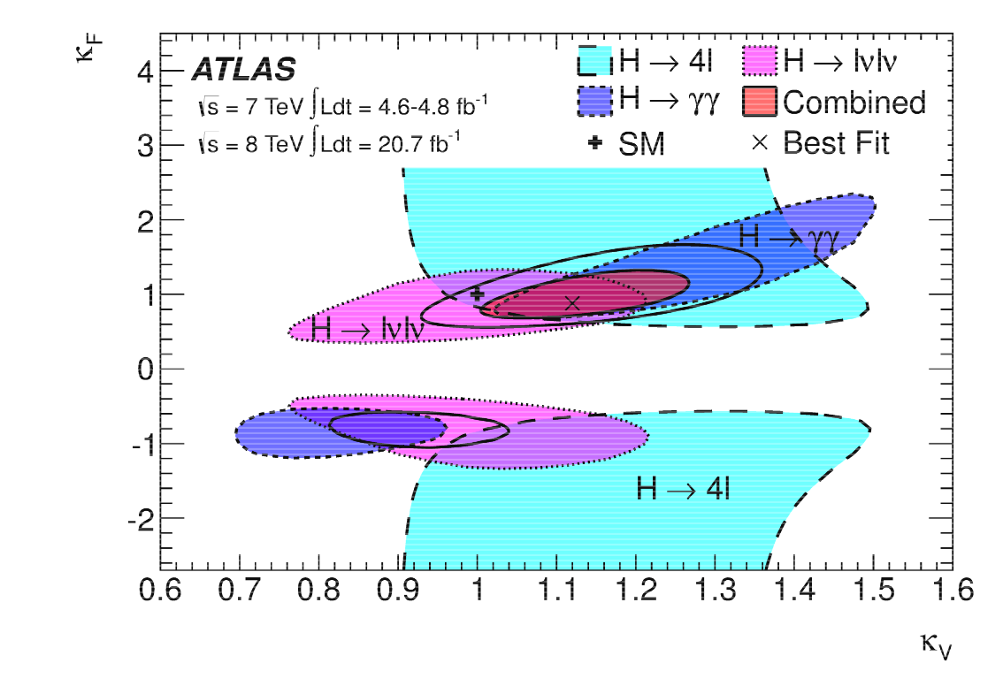
Test of Vector vs Fermion sectors κ_{V}-κ_{F}
Assumptions:
  All Fermion couplings scale as κ_{F} (=κ_{t}=κ_{b}=κ_{τ}=…)
  All Vector Boson couplings scale as κ_{V} (=κ_{W}=κ_{Z})
  No BSM contributions to Γ_{H} → κ²_{H}(κ_{F} κ_{V}) ~ 0.7 κ²_{F} + 0.3 κ²_{V} and κ_{g}(κ_{F} κ_{V}) κ_{γ}(κ_{F} κ_{V})
All experiments compatible with SM predictions: accuracy ~10-20%
      ATLAS: κ_{v} [1.05,1.22] at 68% CL - κ_{F} [0.76,1.18] at 68% CL
      CMS: κ_{v} [0.74,1.06] at 95% CL - κ_{F} [0.61,1.33] at 95% CL
    κ_{F}=0 Excluded at >5σ (mainly indirect via gg loop)

Slide 21
Test of loop induced couplings: κ_{g} vs κ_{γ}
Assumptions:
  Tree-level Coupling to SM particles as in SM: κ_{b}= κ_{W} = κ_{Z} = κ_{τ} = κ_{t} ... = 1
  No BSM contributions to Γ_{H} → κ_{H} ~ 0.9 + 0.1 κ_{g}
Both experiments: compatible with SM predictions - Accuracy ~10-15%
      ATLAS: κ_{g} =(1.04 ± 0.14) at 68% CL - κ_{γ} = (1.20 ± 0.15) at 68% CL
      CMS: κ_{g} [0.63,1.05] at 95% CL - κ_{γ} [0.59,1.30] at 95% CL

Slide 22
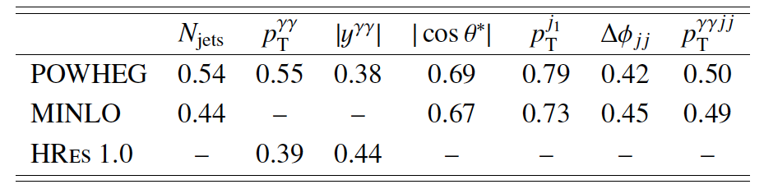
Differential Cross sections in γγ final state
ATLAS: fiducial differential cross-sections
  dσ/dP_{Tγγ}, d|y_{γγ}|, d|cos(θ*)|, dN_{jets}, dφ_{JJ}, ...
  Unfolded to particle level
  Sensitive to: PDF, QCD, production mechanism, spin, Lagrangian tensor structure, ...
  Data in agreement with tested predictions (Powheg, MINLO, Hres1.0) within current experimental accuracy
Probabilities of χ² compatibility tests for
Data vs Predictions for different observables

Slide 23
The Couplings roadmap
Test Higgs boson couplings depending on available L:
  Total signal yield μ: tested at 20% (κ tested at 10%)
  Couplings to Fermions and Vector Bosons 20-30%
  Loop couplings tested at 40%
  *Custodial symmetry W/Z Couplings tested at 30%
  Test Down vs Up fermion couplings
  Test Lepton vs Quark fermion couplings
  Top Yukawa direct measurement ttH: κ_{t}
  Test second generation fermion couplings: κ_{μ}
  Higgs self-couplings couplings HHH: κ_{H}
Today
7+8 TeV
~ 30 fb⁻¹
LHC Upgrade
14 TeV
~ 3000 fb⁻¹

Slide 24
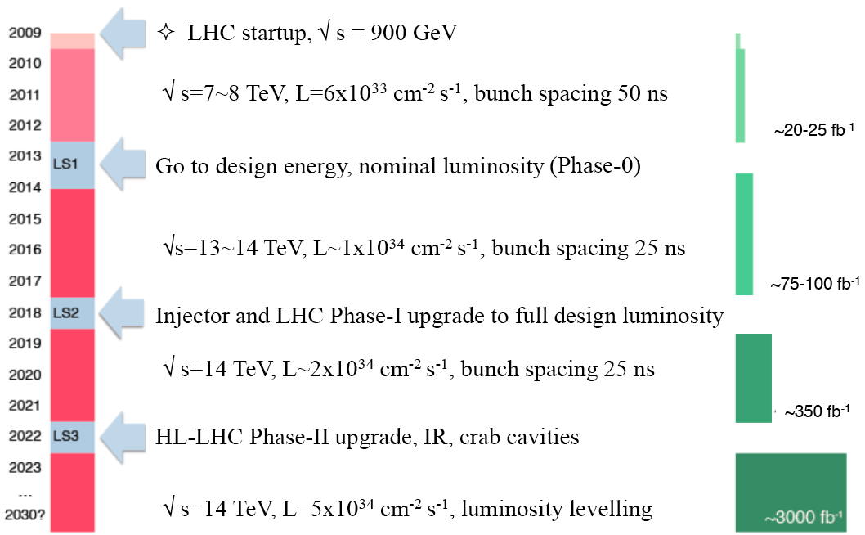
High Luminosity LHC: The timeline
✔ Done
Approved
300 fb⁻¹ at 14 TeV
HL-LHC:
3000 fb⁻¹ at 14 TeV

Slide 25
High Luminosity LHC: the detectors upgrades
Both detectors are planning important upgrades to stand the harsher running conditions at HL-LHC: pile-up, rates, radiation damage
  Pile-up ~ 4-5 times more pile-up then today
Plan: keep detector performance for main physics objects at the same level as we have today
  Improved trigger system
  New tracking systems
  Improved forward detectors
  ….
CRUCIAL to profit of L increase

Slide 26
Signal σ and Yields: HL/HE
Process | 3000 fb⁻¹ 14 TeV | 300 fb⁻¹ 33 TeV
ggH→γγ | 350k | 123k
ggH→4l | 19k | 6.7k
ttH→γγ | 42k | 30k
ttH→4l/μμ | 0.2k/0.4k | 0.16k/0.3k
ggH→HH→bbγγ | 270 | 160
LHC upgrades give access to rare decays
Better signal Yields at HL-LHC
BUT Pile-up and S/B better at HE-LHC
8 → 33 TeV: ggH x9.2 14 → 33 TeV: ggH→ HH x6

Slide 27
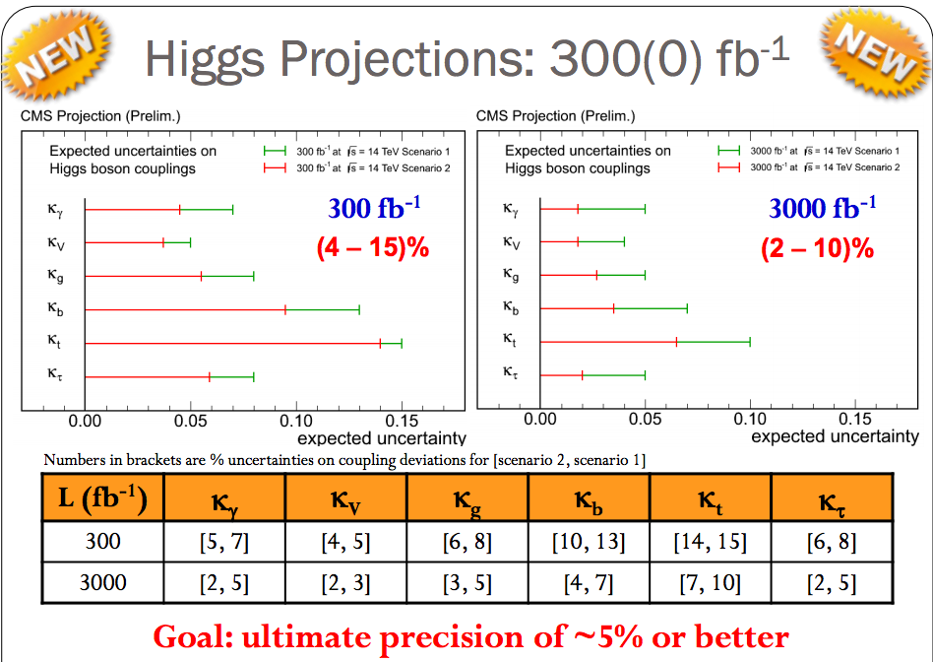
CMS: Couplings f at HL-LHC
CMS Projection
Assumption NO invisible/undetectable contribution to Γ_{H}:
- Scenario 1: system./Theory err. unchanged w.r.t. current analysis (also unchanged)
- Scenario 2: systematics scaled by 1/sqrt(L), theory errors scaled by ½
γγ loop at 2-5% level
down-type fermion couplings at 2-10% level
direct top coupling at 7-10% level
gg loop at 3-5% level

Slide 28
ATLAS: Coupling Ratios at HL-LHC
Fit to coupling ratios:
  No assumption BSM contributions to Γ_{H}
  Some theory systematics cancels in the ratios
Loop-induced Couplings γγ and gg treated as independent parameter
  κ_{γ}/κ_{Z} tested at 2%
  gg loop (BSM) κ_{t}/κ_{g} at 7-12%
  2nd generation ferm. κ_{μ}/κ_{Z} at 8%

Slide 29
HL-LHC outlook
LHC 300 fb⁻¹ at 14 TeV:
Mass: <100 MeV (statistical)
Coupling κ rel. precision*
  Z, W, b, τ 10-15%
  t, μ 3-2 σ observation
  γγ and gg 5-11%
HL-LHC 3000 fb⁻¹ at 14 TeV:
Mass: << 50 MeV (statistical)
Couplings κ rel. precision*
  Z, W, b, τ, t, μ 2-10%
  γγ and gg 2-5%
*Assuming sizeable (1/2) reduction of theory errors
- “QCD scale” go to Higher order QCD computation ?
- gg “PDF” from LHC data ?
Mass Measurement:
Several exp./theory challenges to reach 50 MeV (e/γ/μ calibration E-scale, Interference, FSR, ..)

Slide 30
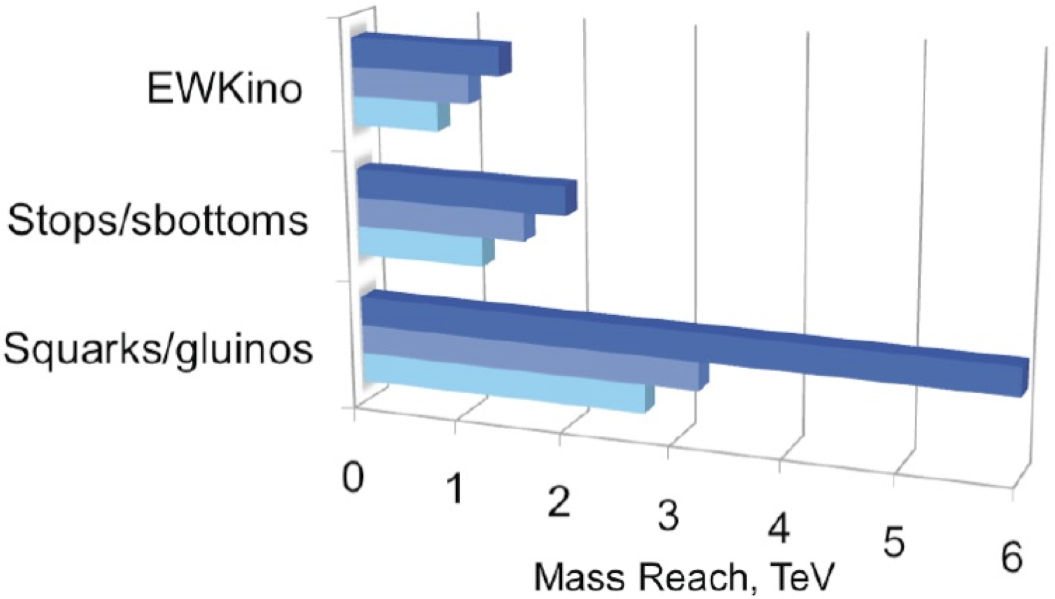
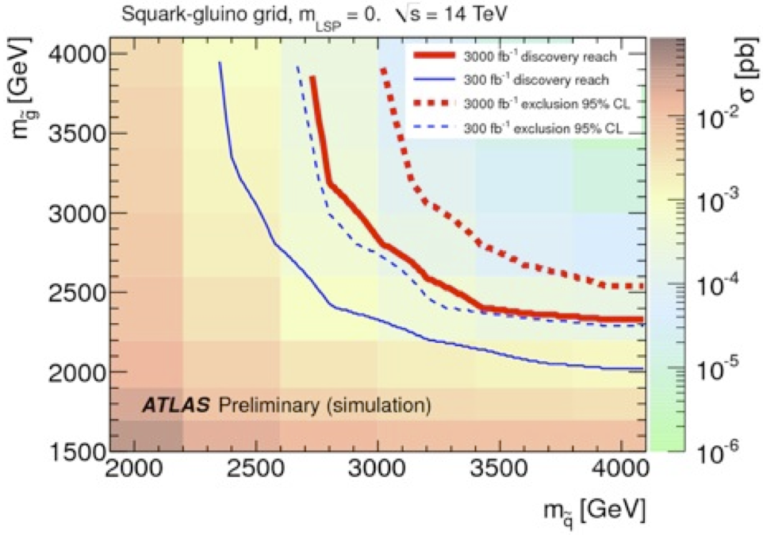
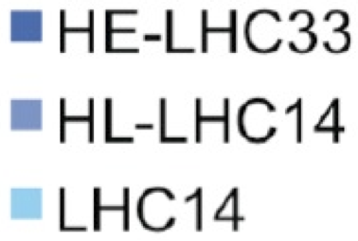
HE-LHC outlook
Geared towards New Physics Discovery (hinted at by precision studies?)
  All existing projects do have an energy-frontier upgrade programme
LHC 7 TeV will be upgraded to LHC 14 TeV in 2015
  And possibly to HL-LHC (14 TeV) in ~2025
  Take-home (simplified) messages :
    1) Absence of discovery at LHC-14 wipes out SUSY below 700 GeV+
      And below several TeV for non-SUSY New Physics
    2) No excess at LHC-14 makes a discovery quite unlikely at HL-LHC
    3) Energy does better than luminosity for direct search for New Physics

Slide 31
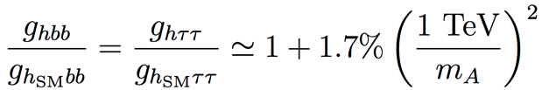
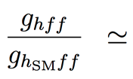
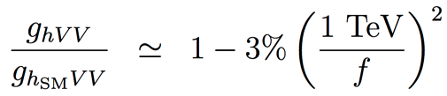
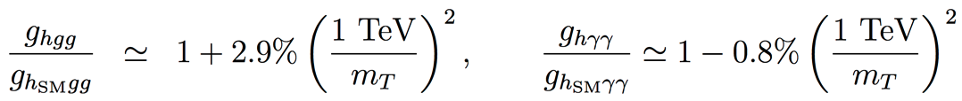
Precision Needed (I) : Higgs Properties
A few examples of BSM Physics
  Max. deviations to SM couplings, as a function of New Physics scale:
    SUSY , for tanβ = 5
    Composite Higgs
    Top partners
    Other models may give up to 5% deviations with respect to the SM
Precision needed
  Need at least a per-cent accuracy on couplings for a 5σ “observation”
    And a sub-per-cent accuracy for a multi-TeV New Physics Scale
      Hence colliders beyond (HL)-LHC
        Towards a Precision Higgs Factory ?
H. Baer, M. Peskin et al.

Slide 32
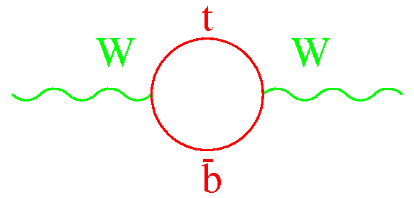
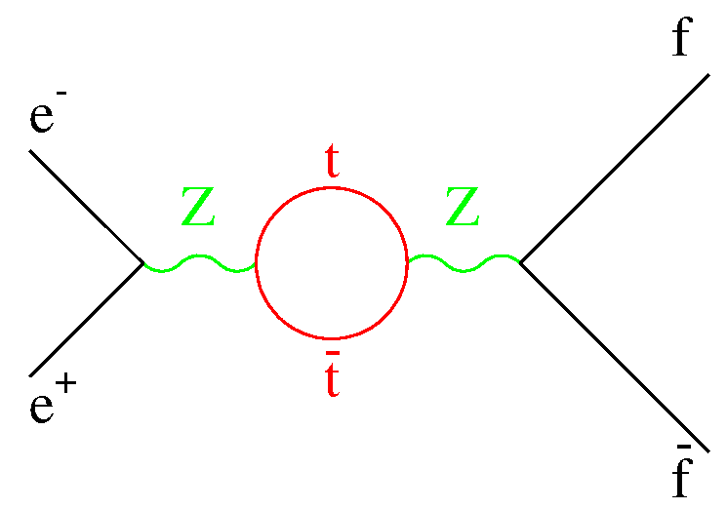
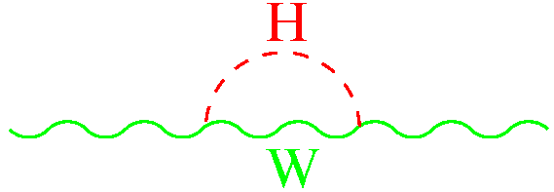
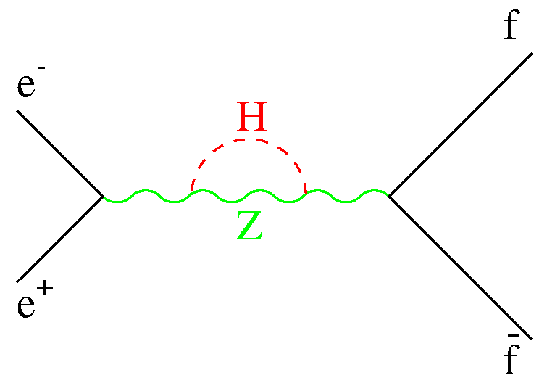
Parameters (II) : EWSB Tests
Improve the precisions of all ESWB tests
  Need to measure better
    m_{W} and m_{top} Reduce the size of the blue ellipse
    Z lineshape, Asymmetries, Cross section, Decay Rates, … and of the red potatoe
  Need to compute better loop corrections to all these observables
Moriond EW ’12
Z pole measurements
Standard Model
Direct m_{W}, m_{top}
measurements

Slide 33
Precision needed (II) : EWSB Tests
For a meaningful test of the SM closure to be done
  Hence to become sensitive to heavier new physics
    Reduce the size of the blue ellipse to approach the thickness of the green line
      i.e., by one order of magnitude or more
    Reduce the size of the red ellipse to that of the blue one
      i.e., by two orders of magnitude or thereabout
Numerically
  m_{W} is known to 15 MeV (Tevatron), ultimately reduced to 10 MeV
    … and maybe to 7 MeV when combined to forthcoming LHC measurements
  m_{top} is know to 1 GeV (Tevatron + LHC), ultimately reduced to 500 MeV
  Also need to increase the statistics at the Z pole significantly
      Precision needed : m_{W} to better than 1 MeV and m_{top} to better than 50 MeV
      (and reduce accordingly the relevant systematic and theory uncertainties)
      Statistics needed : 4 orders of magnitude above the LEP1 accumulated statistics
      (and reduce accordingly the relevant systematic and theory uncertainties)

Slide 34
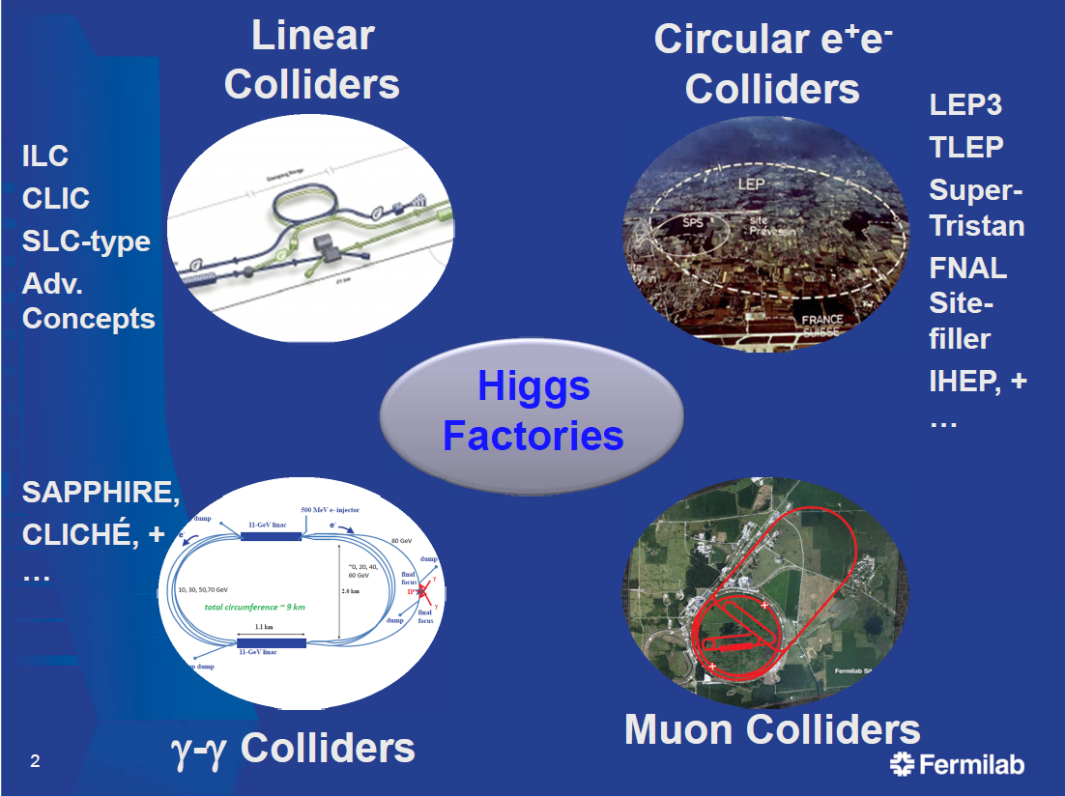
Possible Precision Higgs Factories
Several options for Higgs factories are being studied
More recent proposals
Known technology
Largest Luminosities
Studied for decades
Lots of R&D needed
Small luminosities
Not encouraged by
European Strategy
Smallest Physics
Potential
No Z, W, top
e⁺e⁻ colliders have largest potential
as Precision Higgs Factories

Slide 35
e⁺e⁻ Higgs Factories studies in the world
e⁺ e⁻
Linear
Colliders
CLIC
Circular Colliders
CERN
KEK
ILC
(250 GeV + Klystron based?)
SuperTristan, 40 to 80 km tunnel
250 - 350 GeV
500 (1000?) GeV
LEP3 in LHC tunnel: 90-240 GeV
500 GeV to 3 TeV
TLEP, 80/100 km tunnel: 90-350 GeV
IHEP
CHF, 50 or 70 Km tunnel
FNAL
100 km tunnel

Slide 36
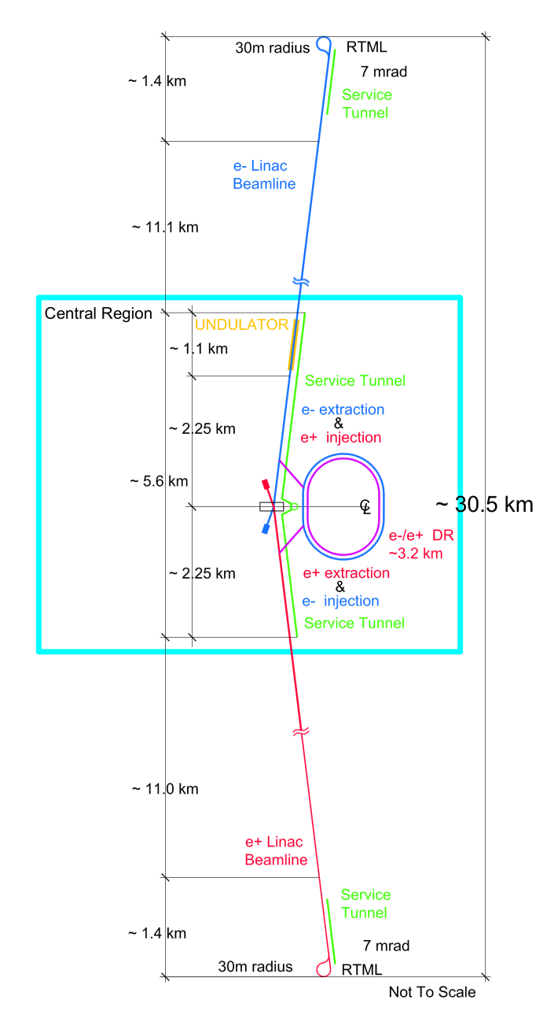
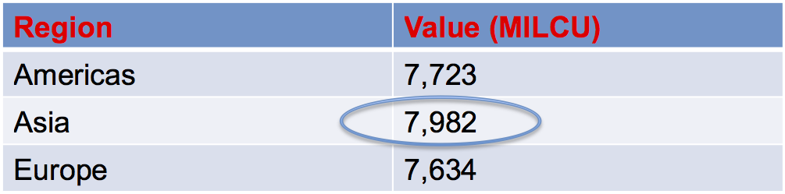
Some ILC Challenges (cost)
Cost in Million $
  About 8 Billion $ for the 500 GeV version
    About 12 Billion $ for the 1 TeV version
  Does not cover a number of items
    Detectors
      About 1 Billion per detector
    Site construction, infrastructure engineering
      Including land acquisition, tunnel, …
        Check-out the cost for CERN construction
    Remaining R&D, prototyping, etc.
  Grand-total estimates err around 25 Billion $
~30km
500GeV

Slide 37
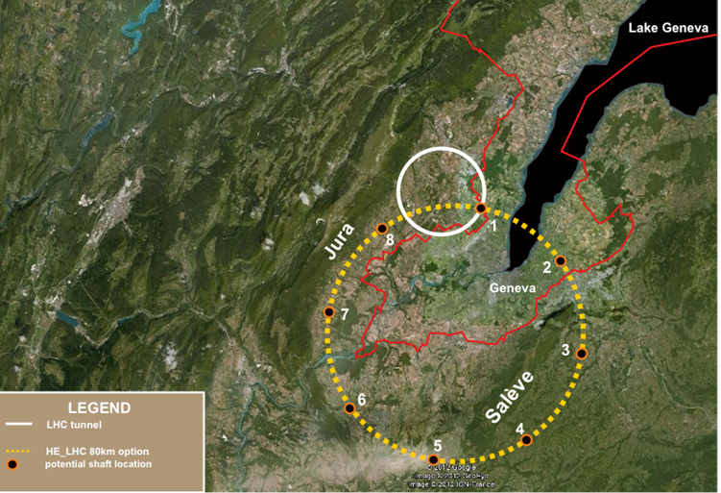
Some TLEP Challenges (cost)
Cost in billion CHF
  Similar to ILC – but site exists already (if at CERN)
Bare tunnel | 3.1 ⁽¹⁾
Services & Additional infrastructure (electricity, cooling, service cavern, RP, ventilation, access roads …) | 1.0⁽²⁾
RF system | 0.9 ⁽³⁾
Cryo system | 0.2 ⁽⁴⁾
Vacuum system & RP | 0.5⁽⁵⁾
Magnet system for collider & injector ring | 0.8⁽⁶⁾
Pre-injector complex SPS reinforcements | 0.5
Total | 7.0
Note: detector costs not included – count 0.5 per detector (LHC)
Preliminary
Not endorsed by anybody
LEP/LHC
(1): J. Osborne, Amrup study, June 2012
(2): Extrapolation from LEP
(3): O. Brunner, detailed estimate, 7 May 2013
80-100 km tunnel
(4): F. Haug, 4th TLEP Days, 5 April 2013
(5): K. Oide : factor 2.5 higher than KEK,
estimated for 80 km ring
(6): 24,000 magnets for collider & injector;
cost per magnet 30 kCHF (LHeC);

Slide 38
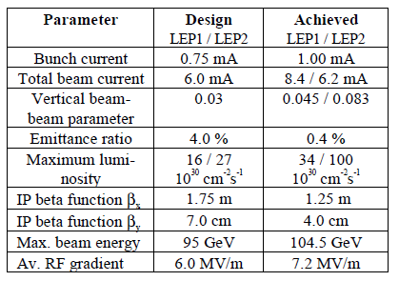
ILC/TLEP Extrapolations
Extrapolation from past experience
        beam size @ IP nm
  SuperKEKB will be an excellent test-bench for TLEP
    In many respects
  Will also learn a lot from ATF2
  Lot of work ahead to reach ILC beam dimensions
  Estimates for circular colliders historically reliable
F. Zimmermann
 | LEP2→TLEP-H | SLC→ILC 250
peak luminosity | × 400 | × 2500
energy | × 1.15 | × 2.5
vertical geom. emittance | × 1/5 | × 1/400
vert. IP beam size | × 1/20 | × 1/150
e⁺ production rate | × 0.5 ! | × 65
RF System Length | × 0.8 ! | × 10
commissioning time | <1 year → ? | >10 years →?
LEP2 | 3500
KEKB | 940
SLC | 500
LEP3 | 320
TLEP-H | 140
ATF2, FFTB | 72, 65
SuperKEKB | 50
SAPPHiRE | 18
ILC | 5 – 8
CLIC | 1 – 2

Slide 39
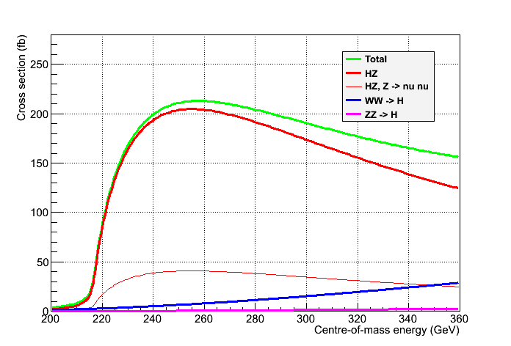
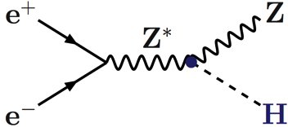
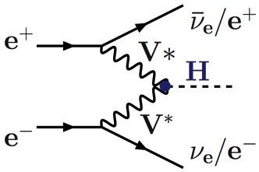
Performance Comparison (1)
Physics case as a Higgs Factory
  Similar : Not driven by the fact that the collider is linear or circular
    Scan of the HZ threshold : √s = 210-240 GeV Spin
    Maximum of the HZ cross section : √s = 240-250 GeV Mass, σ_{HZ,} BRs, Width, …
    Just below or at the tt threshold : √s ~ 340-350 GeV Width
Unpolarized cross sections
PJ and G. Ganis
Z → All
Z → νν

Slide 40
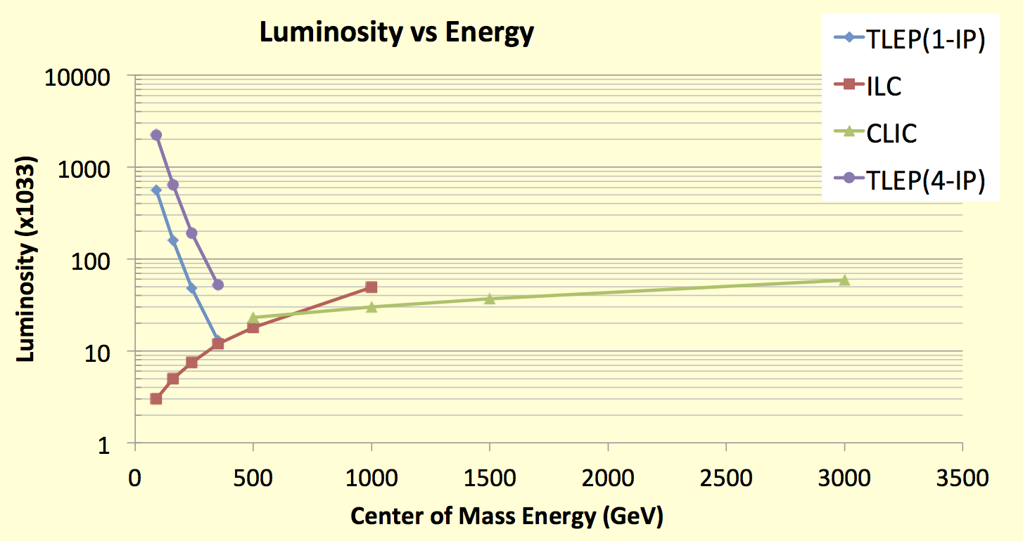
Performance Comparison (2)
Luminosity : Circular colliders can have several IP’s
  Note : Lumi upgrade (×3) now envisioned at ILC : luminosity is the key at low energy !
    Crossing point between circular and linear colliders ~ 450 GeV
TLEP : Instantaneous lumi at each IP (for 4 IP’s)
Instantaneous lumi summed over 4 IP’s
Z, 2.10³⁶
WW, 6.10³⁵
HZ, 2.10³⁵
tt , 5.10³⁴
R. Aleksan

Slide 41
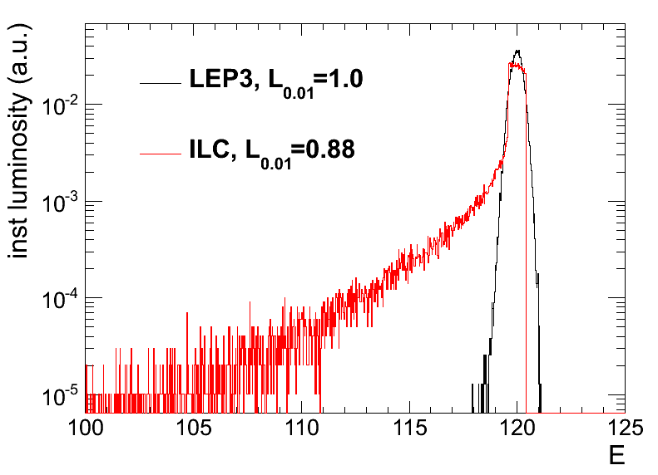
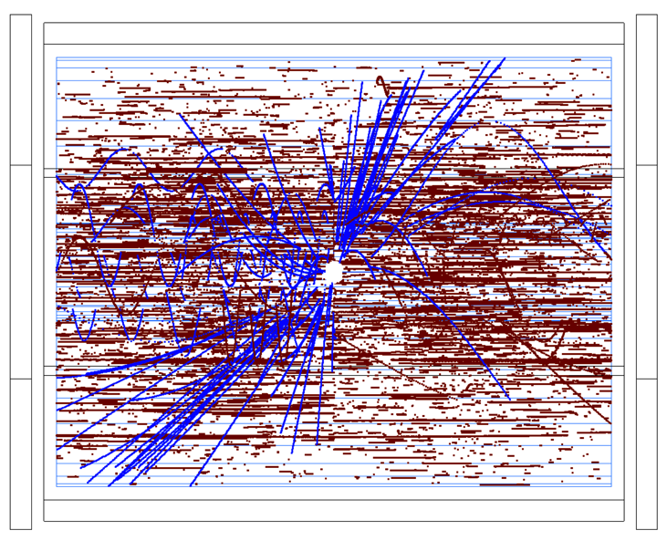
Performance Comparison (3)
Number of Higgs Bosons produced at √s = 250 & 350 GeV
  Beam polarization not critical for Higgs boson studies (40% cross section increase)
    Beamstrahlung is critical
      Beam energy
      γγ Pileup
      Beam backgrounds
      Luminosity measurement
      …
 | ILC-250 | TLEP-240 | ILC-350 | TLEP-350
Lumi / IP / 5 yrs | 250 fb⁻¹ | 2.5 ab⁻¹ | 350 fb⁻¹ | 650 fb⁻¹
# IP | 1 | 4 | 1 | 4
Lumi / 5 yrs | 250 fb⁻¹ | 10 ab⁻¹ | 350 fb⁻¹ | 2.5 ab⁻¹
Beam Polarization | 80%, 30% | – | 80%,30% | –
L_{0.01} (beamstrahlung) | 88% | 100% | 80% | 100%
# of HZ events | 70,000 | 2,000,000 | 65,000 | 325,000
# of WW→H events | 1,500 | 50,000 | 12,000 | 65,000
M. Zanetti
ILD TPC at 500 GeV

Slide 42
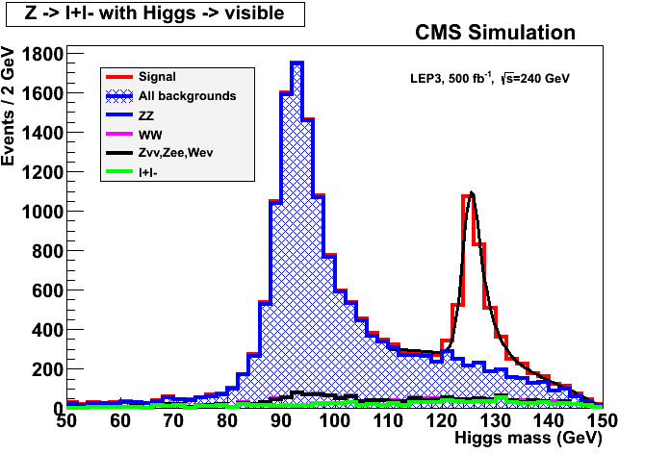
Performance Comparison (4)
Example : e⁺e⁻ → ZH → l⁺l⁻ + anything
  Measure σ_{HZ} ~ g²_{HZZ}
Summary of measurements
e⁻
H
 | ILC-250 | TLEP-240
σ_{HZ} | 2.5% | 0.4%
σ_{HZ} ✕BR(H→bb) | 1.0% | 0.1%
σ_{HZ} ✕BR(H→cc) | 6.9% | 1.3%
σ_{HZ} ✕BR(H→gg) | 8.5% | 1.4%
σ_{HZ} ✕BR(H→WW*) | 8.0% | 0.9%
σ_{HZ} ✕BR(H→ττ) | 5.0% | 0.9%
σ_{HZ} ✕BR(H→ZZ*) | 28% | 3.1%
σ_{HZ} ✕BR(H→γγ) | 27% | 3.0%
σ_{HZ} ✕BR(H→μμ) | – | 13%
Γ_{INV} / Γ_{H} | < 1.5% | < 0.3%
m_{H} | 40 MeV | 8 MeV
 | ILC-350 | TLEP-350
σ_{WW→H} | 3% | 0.5%
Γ_{H} | 5.5% | 1.1%
Z*
e⁺
    g_{HZZ}
Z
e⁻, μ⁻
e⁺, μ⁺
TLEP-240
1 year
1 detector

Slide 43
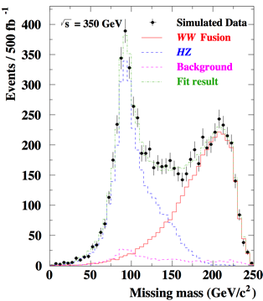
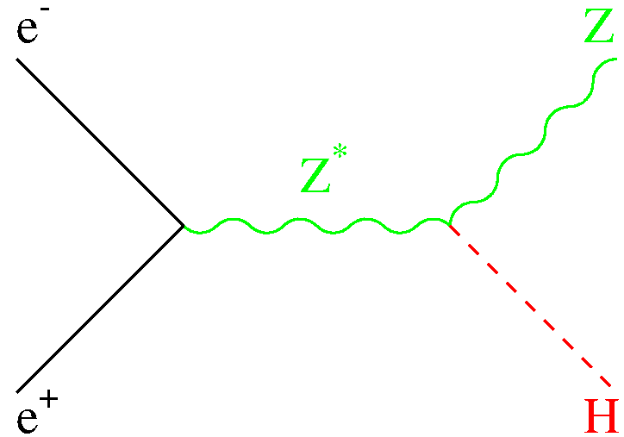
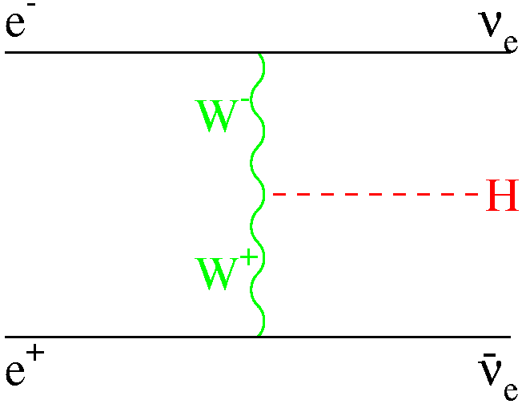
Performance Comparison (5)
Determination of the total width
  From the number of HZ events and of ZZZ events at √s = 240 GeV
  From the bbνν final state at √s = 350 GeV
-
ν
ν
 | ILC | TLEP
Γ_{H} | 5.5% | 1.1%

Slide 44
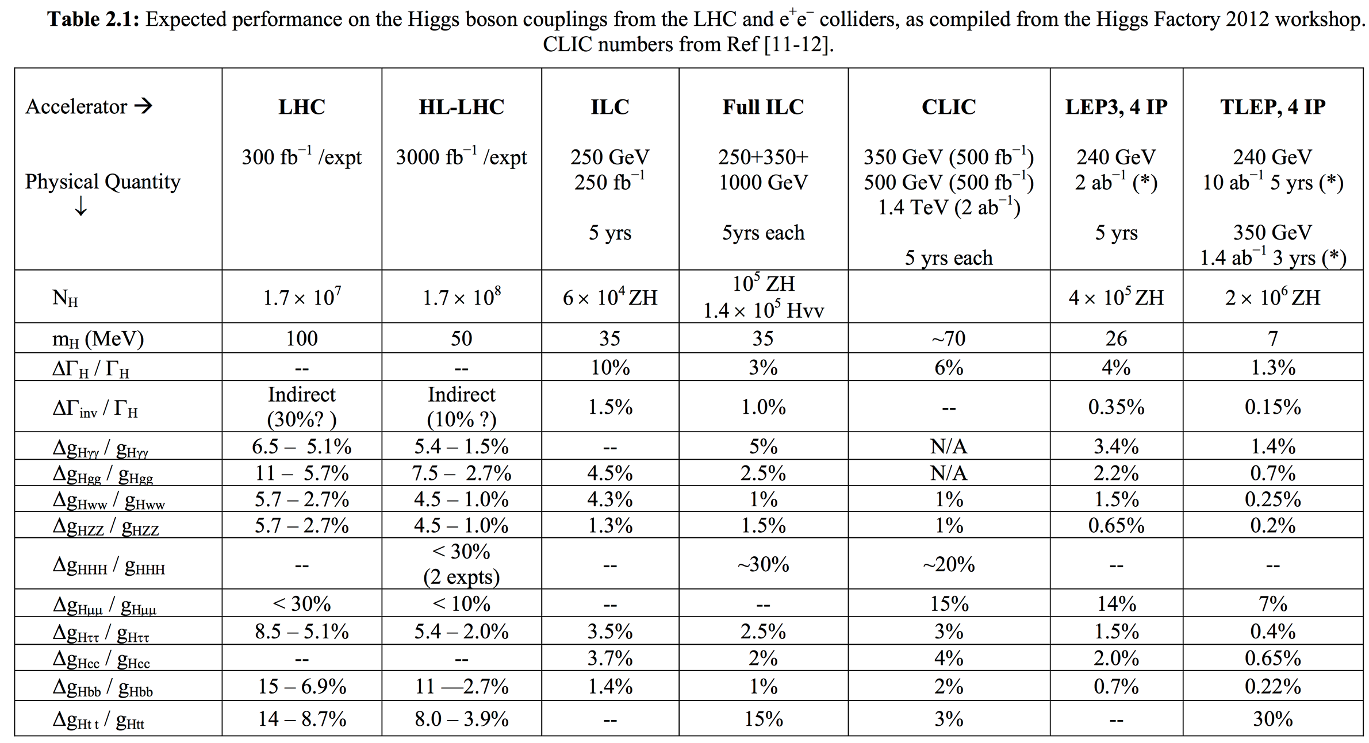
Performance Comparison (6)
Precision on couplings, cross sections, mass, width, …
  Summary of the ICFA HF2012 workshop (FNAL, Nov. 2012)
Best
precision

Slide 45
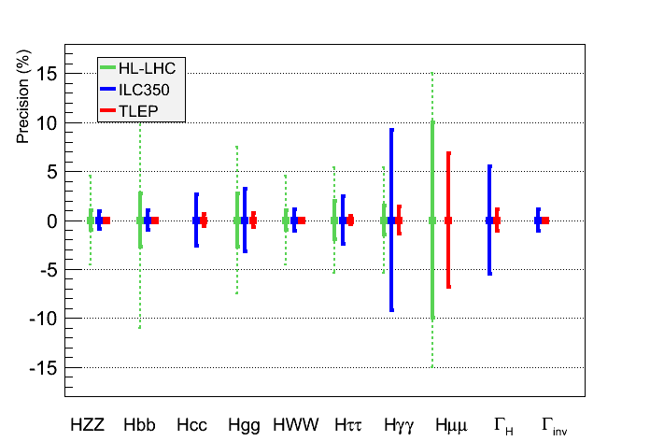
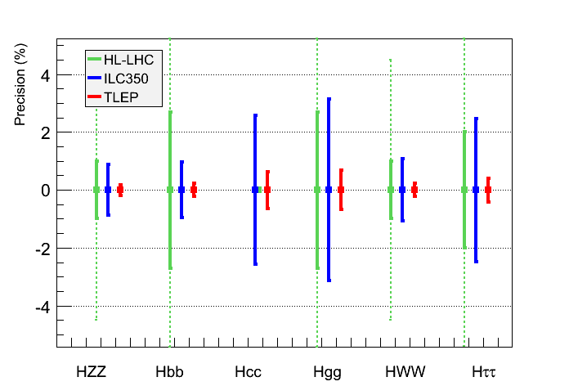
Performance Comparison (7)
Same assumptions as for HL-LHC for a sound comparison
  Assume no exotic decay for the Higgs boson
    ILC complementary to HL-LHC (g_{Hcc}, Γ_{H}, Γ_{inv})
      TLEP reaches the sub-per-cent precision (>1 TeV BSM Physics)
J. Ellis et al.
      Progress on the theoretical side also needed

Slide 46
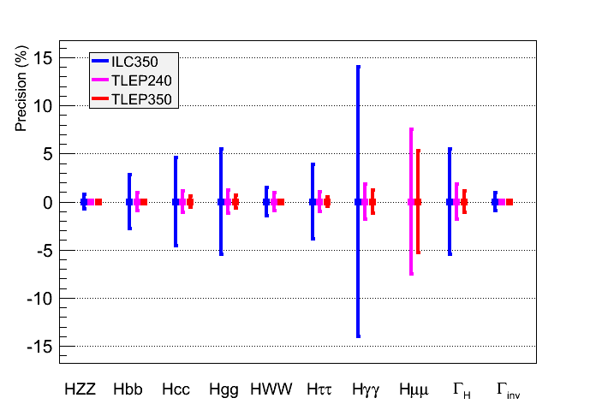
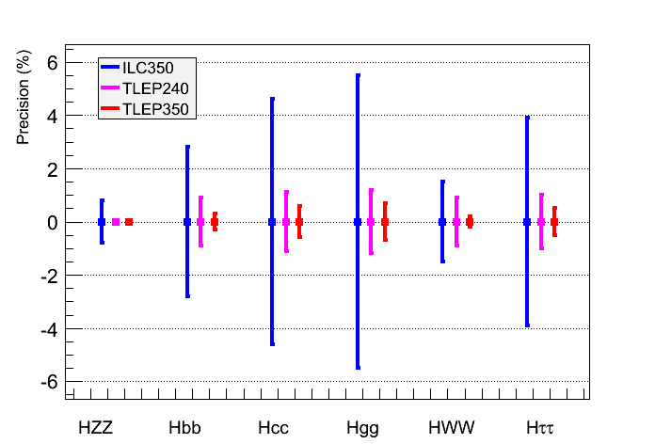
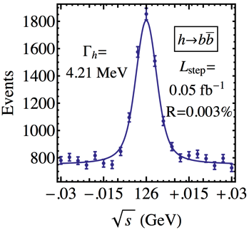
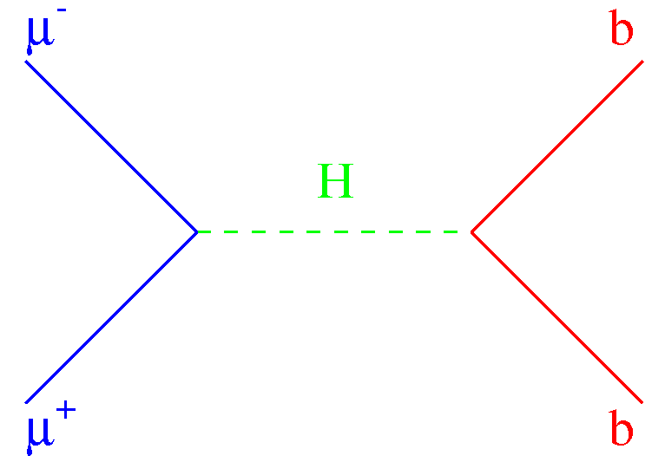
Performance Comparison (8)
Conclusion reinforced when Γ_{H} is a free parameter in the fit
    TLEP : sub-percent precision, adequate for BSM Physics sensitivity beyond 1 TeV
  Note : Determination of the total width better with e⁺e⁻ collider than with μ⁺μ⁻ collider
, W, …
_{, W, …}
  Expected precision on the total width
μ⁺μ⁻ | ILC350 | ILC1000 | TLEP240 | TLEP350
5% | 5% | 3% | 2% | 1%

Slide 47
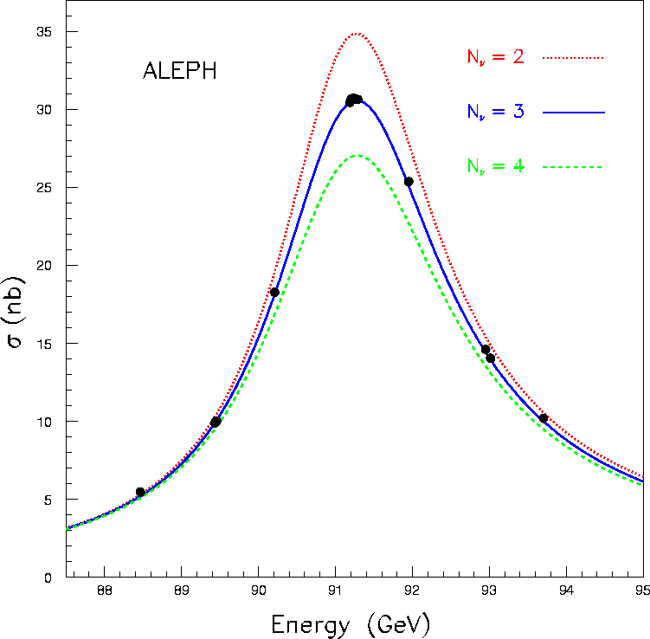
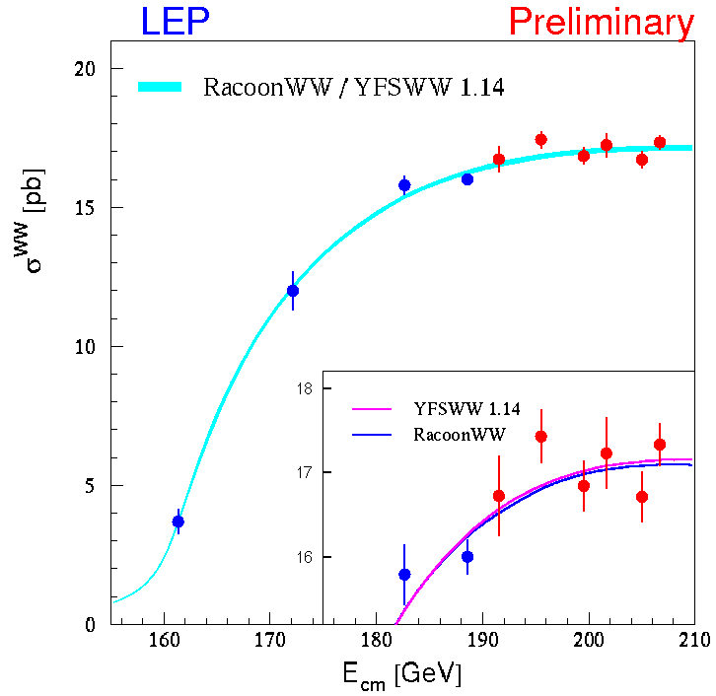
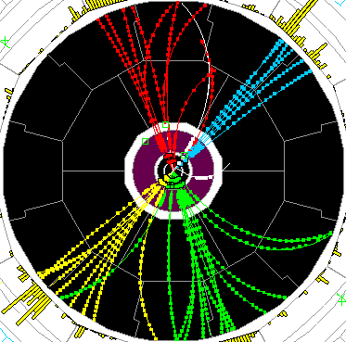
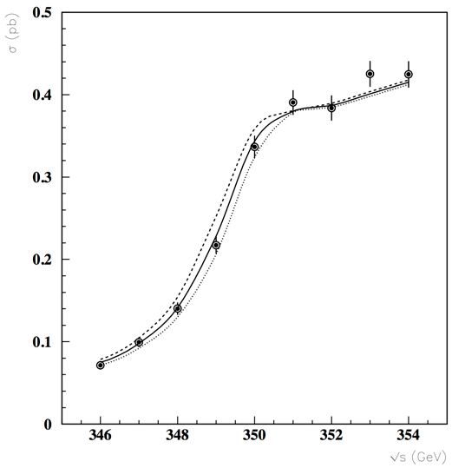
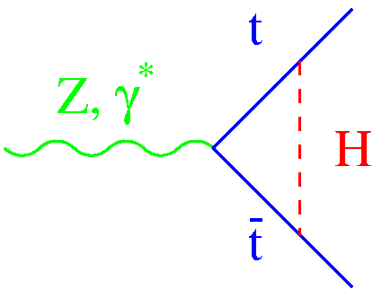
Performance Comparison (9)
Precision tests of EWSB
  TLEP meets the precision requirements (slide 8)
Asymmetries, Lineshape
 | LEP | ILC | TLEP
√s ~ m_{Z} | Mega-Z | Giga-Z | Tera-Z
#Z / year Polarization Precision vs LEP1 Error on m_{Z}, Γ_{Ζ} | 2×10⁷ Yes (T) 1 2 MeV | Few 10⁹ Easy 1/5 to 1/10 – | 10¹² (>10¹¹ b,c,τ) Yes (T,L) ~1/100 < 0.1 MeV
√s ~ 2m_{W}
#W pairs / year Polarization Error on m_{W} | Few dozens No 220 MeV | 2×10⁵ Easy 7 MeV | 2.5×10⁷ Yes (T) 0.5 MeV
√s = 240 GeV |  |  | Oku-W
# W pairs / 5 years Error on m_{W} | 4×10⁴ 33 MeV | 4×10⁶ 3 MeV | 2×10⁸ 0.5 MeV
√s ~ 350 GeV |  |  | Mega-Top
# top pairs / 5 years Error on m_{top} Error on λ_{t} | – – – | 100,000 30 MeV 40% | 500,000 13 MeV 15%
WW threshold scan
WW production
-
tt threshold scan

Slide 48
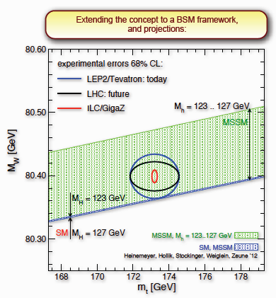
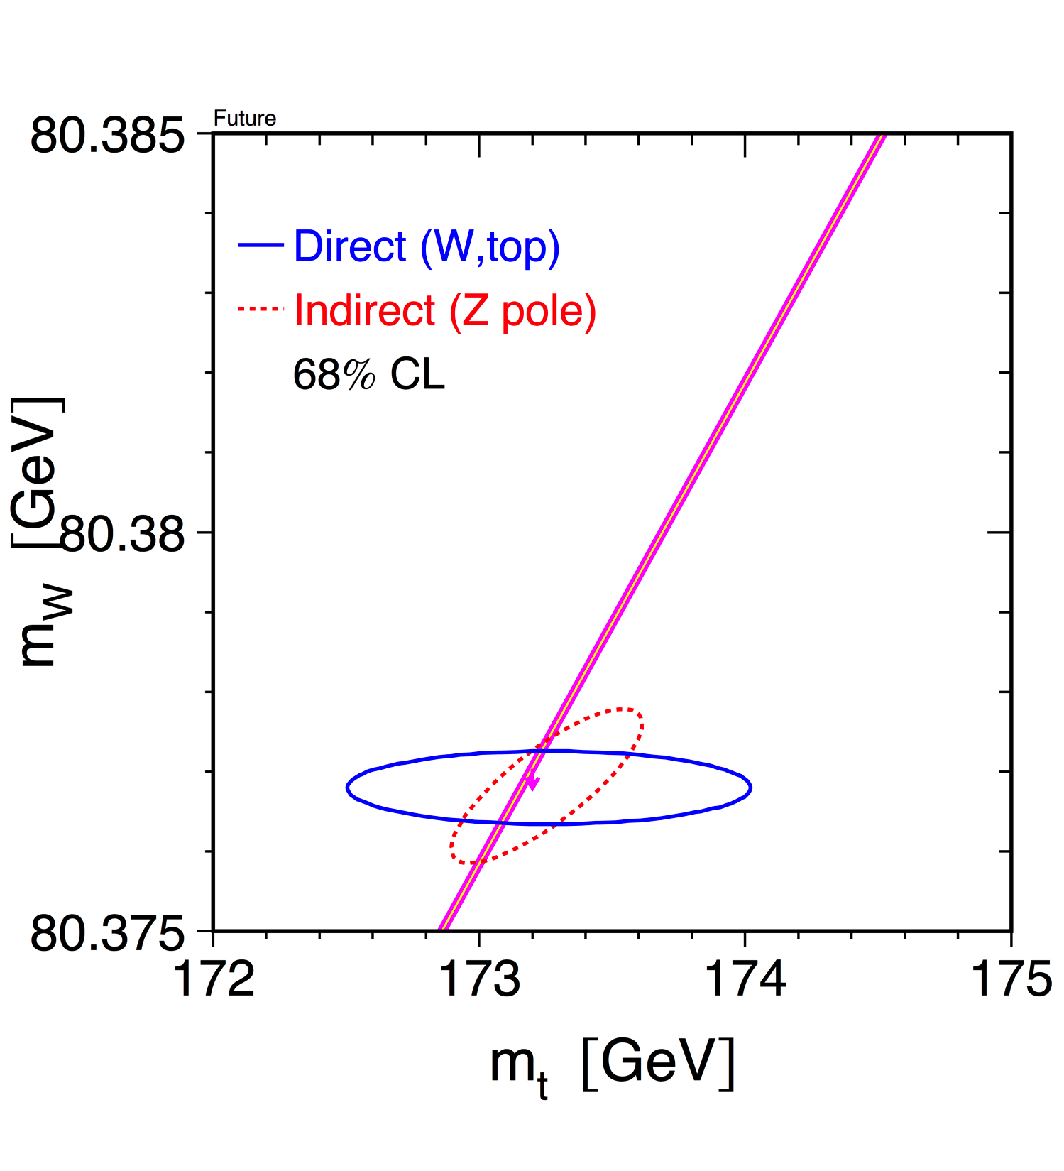
Performance Comparison (10)
lkjfs
Warning : indicative only.
Complete study being done
m_{H}=126 GeV
ILC
TLEP
TLEP
Very stringent SM closure test.
Sensitivity to weakly-interacting
multi-TeV BSM Physics.

Slide 49
The Next-to-Next Facility (1)
ILC350 can be upgraded to ILC500
  And possibly to ILC1000
    Could discover New Physics below 500 GeV (via pair production)
      Air might get extremely thin after three years with LHC-14.
  Take-home messages
    New Physics discovery potential of ILC will be quite limited, even at 1 TeV
    It is essential to wait for the LHC-14 results before engaging in ILC
      Appropriate decision time is the next European Strategy update
  Discoveries at LHC-14 might point to the need of a 3-TeV e⁺e⁻ machine (CLIC)
    Only if some kind of New Physics is found below 1.5 TeV
    Lots of R&D still needed towards a TDR
      100 MV/m accelerating gradient
      Very small beam size (1 nm)
      Very short bunches (150 ns)
      Ultra-precise alignment
      Magnet stabilization
      Large wall plug power (600 MW)
      …
Energy CM (GeV) | 500 | 3000
Luminosity (x10³⁴cm⁻²s⁻¹) | 2.3 | 5
Beam size (σ_{x}/σ_{y} nm) | 202/2.3 | 40/1
Pulse duration (ns) | 177 | 155
Beam power (MW) | 4.9 | 14
Total AC power (MW) | 270 | 589

Slide 50



The Next-to-Next Facility (2)
TLEP can be upgraded to VHE-LHC
  Re-use the 80 km tunnel to reach 80-100 TeV pp collisions
    Or re-use the LHC tunnel to reach 27-33 TeV pp collisions
  In both cases, need to develop 16-20 T SC magnets
    Needs lots of R&D and time (TLEP won’t delay VHE-LHC)
  First consistent conceptual design
    Using multiple SC materials
Could explore higher-energy regions (up to 10 TeV and more)
Detailed conceptual study of the machine is needed
Intense collaborative R&D is necessary
Physics case must be better understood
L. Rossi
20 T field!

Slide 51
Conclusion
1 year after the discovery properties of the New boson measured with increasing precision thanks to outstanding LHC performance and improved analysis:
  Mass measured at the 3 per mill level
  Evidence for scalar nature 0⁺ (though CP mixing not excluded)
  Evidence for couplings to Fermions: direct >3σ and indirect >5σ
  Evidence for V-mediated and VBF production
  Coupling Tests compatible with SM predictions
All measured properties compatible with the SM Higgs boson
Coming soon: final RUN1 publications from CMS and ATLAS
In 2015 LHC will increase E_{CM} (σ_{H}~2.6) and Luminosity (10³⁴cm⁻²s⁻¹)
  Increase sensitivity to challenge the SM predictions:
  This is just the beginning of a rich “Higgs physics program” !
  High precision higgs physics (sensitivity to BSM) needs for an Higgs factory
It is important to choose the right machine for the future
  Cannot afford to be wrong for 10 billion CHF – it would be the end of HEP
Many options on the market: results of the LHC run at 14 TeV will be a necessary and precious input to this decision
Today a new e⁺e⁻ storage ring seems the best option

Slide 52
Backup Slides

Slide 53


TLEP-Z , TLEP-W: A few remarks (1)
TLEP-Z : Hadronic Z event rate ~ 15 kHz in each detector
  Trigger rate 15 times larger than in LHC experiments
    Event size / reconstruction time 20 times smaller
  Bunch crossing rate similar to LHC (4000 bunches over 80km)
    Need similarly fast detector / electronics
  LEP1 physics programme can be repeated every 15 minutes
    A trillion Z decays (10¹²) in one year
    A great tool for detector calibration for higher √s runs
Ultra-precise beam energy measurement is required
  Resonant depolarization unique @ circular machines
    Intrinsic precision ~ 100 keV (LEP1) / measurement
      Decreases like 1 / √#(Measurements)
  Requires beam transverse polarization
    In one non-colliding bunch, during operations
      Continuous energy measurement
      No extrapolation needed (tides, trains, rain…)
  Can measure m_{Z} and Γ_{Z} to better than 0.1 MeV
    To be compared to 2 MeV at LEP1

Slide 54
TLEP-Z , TLEP-W: A few remarks (2)
TLEP-Z : Measurement of A_{LR} requires longitudinal polarization
  Will require spin rotators, polarimeters
    And the real challenge : keep the polarization during collisions
      A dedicated run with lower luminosity is envisioned
      Towards measuring sin²θ_{W} with a precision of 2.10⁻⁶
TLEP-W : Measurement of m_{W} requires transverse polarization too
  Towards the precise measurement of the beam energy
    Statistical precision on m_{W} of 0.5 MeV is at hand
  Straight extrapolations from LEP show that it’s possible
    Got 5% polarization at E_{beam} = 60 GeV
      With 80 km, can have 5% at 81 GeV
  E_{beam} measurement at higher √s will use ZZ and Z(γ) events
A lot of work to be done
  On the theoretical side
  On the experimental systematic effects
    To match theory and experimental uncertainties to the statistical uncertainties

Slide 55

TLEP-t : A few remarks
337 339 341 343 345 347 349 351 (m_{top} = 172.5 GeV)
Scan of the tt threshold
  Observables σ_{tt}, A_{FB} and <p^{@max}> sensitive to m_{top} , Γ_{top} , and λ_{top} (ttH Yukawa coupling)
    Experimental precision for ILC with 100,000 tt events
      No beamstrahlung and 500,000 tt events at TLEP
    Expected sensitivity for TLEP (full study to be done) and ILC
-
-
m_{top} = 175 GeV
TLEP
ILC
σ_{tt}
Increase of cross section and
steeper rise not yet included
p^{@max}
A_{FB}
M. Martinez and R. Miquel, 2003
 | Δm_{top} | ΔΓ_{top} | Δλ_{top}/λ_{top}
TLEP | 15 MeV | 17 MeV | 15%
ILC | 30 MeV | 35 MeV | 40%

Slide 56
Possible Timescale
Similar timescales for TLEP and ILC
  ILC aims for Physics in 2028-2030
TLEP
  Design study : 2013-2017
  Next European Strategy Workshop : 2017-2018
  Decision to go and start digging : 2018-2019
  Start installation in parallel with HL-LHC running : 2023 - …
  Start running at the end of HL-LHC running : 2030 - …
 | 2010 |  |  |  |  |  | 2015 |  |  |  |  | 2020 |  |  |  |  | 2025 |  |  |  |  | 2030 |  |  |  |  | 2035 |  |  | … |  | 2050
LHC
HL-LHC | R&D + constr
TLEP |  |  |  | Design + R&D + construction
VHE-LHC | Design + R&D + construction

Slide 57





The Next-to-Next Facility (4)
Performance comparison for the SM Higgs boson
  Measurement of the more difficult couplings : g_{Htt} (Yukawa) and g_{HHH} (self)
    In e⁺e⁻ collisions
    In pp collisions
H
H
M. Mangano
HE-LHC
VHE-LHC
H
H
H

Slide 58

The Next-to-Next Facility (4)
Performance comparison for the SM Higgs boson (cont’d)
  Only ttH and HHH couplings
    Other couplings benefit only marginally from high √s
    VHE-LHC : Largest New Physics reach and best potential for g_{Htt} and g_{HHH}
(NP=New Physics reach)
√s, NP
J. Wells et al.
arXiV:1305.6397
TLEP
√s, NP
HF2012
ILC500, HL-LHC ILC1TeV, HE-LHC CLIC3TeV, VHE-LHC

Slide 59
Constraints on BR_{BSM}
Greg has shown direct search for: ZH→ll-Invisible
  ATLAS: BR_{inv} < 0.60 @ 95% CL (0.84 exp.)
  CMS: BR_{inv} < 0.75 @ 95% CL (0.91 exp.)
We can parameterize: Γ_{H} = Γ_{SM} + Γ_{BSM}
BR_{BSM} = Γ_{BSM}/Γ_{H}
This quantity is sensitive also to other undetectable decay modes: H → light hadrons
ATLAS:
  Assumptions three-level couplings: κ_{b}=κ_{W} ..= 1
  3 Fitted Par.: κ_{γ} κ_{g} + BR_{BSM}
  BR_{BSM} < 0.60 @ 95% CL (0.67 exp.)
CMS:
  Assumption: κ_{V} ≤ 1 (motivated by EWSB)
  7 Fitted Par.: κ_{V} κ_{b} κ_{τ} κ_{t} κ_{γ} κ_{g} + BR_{BSM}
  BR_{BSM} < 0.64 @ 95% CL (0.66 exp.)

Slide 60
Couplings Overview
P_{SM} = 12%
P_{SM} = 12%
P_{SM} = 20%
P_{SM} = 14%
Different Sectors of the New Boson Couplings tested: P_{SM}>12%
All compatible with SM Higgs expectations

Slide 61
Mass Measurement: ATLAS
ATLAS tension between γγ and ZZ*(4l) mass measurements
Dedicated Likelihood with different mass parameterization:
M_{H} and ΔM_{H}
ΔM_{H} = 2.3 ± 0.7_{stat} ± 0.6_{sys} GeV = 2.3 ± 0.9_{tot} (M_{H} “profiled”)
Probability to observe such a large (or larger) difference if ΔM_{H} = 0 evaluated at 1.5% (2.4σ)
If main systematics on Electromagnetic-Energy Scale shifted by 1σ probability increases to 8%
Updates final γγ and ZZ*(4l) publications this fall:
  better EES calibration (material description, ..), improved ZZ* mass analysis (MVA techniques, event by event errors, ..)

Slide 62



Spin-Parity determination
Used as test statistics the likelihood ratio q:
Signal strengths μ_{JP} treated as independent Nuisance-Parameter for each channel and each spin hypothesis
Probability distributions for different J^{P} hypothesis derived via pseudo-experiments
When deriving exclusions use CL_{s}:

Slide 63
Test of 0⁺ vs 1⁺ / 1⁻
ATLAS: combined WW*→νlνl + ZZ*→4l
1⁺ Excluded at 99.97% CL (exp. 99.95%)
1⁻ Excluded at 99.7% CL (exp. 99.4%)
CMS: ZZ*→4l
1⁺ Excluded at >99.9% CL (exp. 99.7%)
1⁻ Excluded at >99.9% CL (exp. 99.5%)
Compatible with SM Higgs 0⁺

Slide 64
Test of 0⁺ vs 2⁺_{m} f_{qq} scan
Graviton inspired with minimal couplings to SM particles
Tensor can be produced via gg or qq annihilation
ATLAS: γγ + WW* + ZZ*
2⁺_{m} (100% qq) Excluded at >99.99% CL (exp. >99.99%)
2⁺_{m} (100% gg) Excluded at 99.98% CL (exp. 99.94%)

Slide 65
Production/Decay with Signal above 2σ
Measure: Yields → Production x Decay
  Production modes: gg, VBF, W/ZH, ttH
  Decay Channels: γγ, WW*, ZZ*, bb, ττ, μμ, Ζγ
Observations Above 2σ:
ATLAS:
  Production Modes: gluon-gluon(>5σ), VBF(>3σ), VH
  Decay Channels: WW*(3.8σ), ZZ* (>5σ), γγ(>5σ)
CMS:
  Production Modes: gluon-gluon(>5σ), VH, VBF, (V+VBF)H(>3σ)
  Decay Channels: WW*(4σ), ZZ*(>5σ), γγ(>3σ), ττ, bb, combined ττ+bb (>3σ)
D0+CDF:
  Production Modes: VH(>3σ)
  Decay Channels: bb(>3σ)

Slide 66

Evidence for Direct Couplings to Fermions
TEVATRON: CDF+D0 Combined VH→bb
  2.1σ excess
  σ(VH)×BR(H→bb) = (0.19 ± 0.09) pb - SM for M_{H}=125 GeV → (0.12 ± 0.01) pb
CMS (for M_{H}=125 GeV):
  (VBF+V)H → bb combination 2.1σ excess
  H→ ττ 2.85σ excess
  Combined H→ (ττ + bb) 3.4σ excess
ATLAS (for M_{H}=125 GeV):
    H → ττ μ= (0.7 ± 0.7) (compatible with SM, with or without Higgs boson)
    VH→bb μ= (0.2 ± 0.7) (compatible with SM, with or without Higgs boson)

Slide 67

The Couplings fit
Loop contributions can:
  Expressed as a function of SM couplings
  Treated as free parameter (test possible BSM contributions)
Total width Γ_{H} two kind of assumptions
  - Only SM particles contribute to Γ_{H}(Γ_{i})
  - Measure ratio of couplings λ
κ²_{γγ} = (1.6 κ²_{W} + 0.07 κ²_{t} – 0.67 κ_{W}κ_{t})
LHC-XS wg

Slide 68

Inputs to the Fit
Input to coupling fit: event yields per category k (list of channels/category used in backup)
  N^{k} = n^{k}_{signal} + n^{k}_{background}
Signal scaling factors per Production i and Decay f

Slide 69


LHC Coupling Fit: statistical approach
Use profile likelihood ratio:
a Parameter(s) of Interest: Signal Strength, Coupl. scale factor, Mass, …
θ Nuisance parameter(s): Systematics, …
CL intervals: Asymptotic approximation:
  1D: 68% q(a) = 1 - 95% q(a) = 3.84
  2D: 68% q(a_{i},a_{j}) = 2.3 - 95% q(a_{i},a_{j}) = 6
  Cross checked with “pseudo-experiments”

Slide 70
Evidence for different Production modes
Model independent fit to μ_{VBF+VH}/μ_{gg+ttH} in different channels (BR’s cancels out):
ATLAS: Evidence for VBF production 3.1σ
CMS: Evidence for V-boson mediated production

Slide 71

Test of W/Z coupling: λ_{W/Z}
Ratio is independent of assumptions on Γ_{H}
Tested under different assumptions
  More model independent: using only “untagged” WW* and ZZ* channels
    CMS: λ_{W/Z} [0.60,1.40] at 95% CL
    ATLAS: λ_{W/Z} = (0.81 ± 0.16) at 68% CL
  Assuming SM content in γγ loop and using VBF+VH production
    ATLAS: λ_{W/Z} [0.61,1.04] at 68% CL
    CMS: λ_{W/Z} [0.62,1.19] at 95% CL
Compatible with SM prediction:
Accuracy ~20%

Slide 72
6 parameters fits: κ_{V} κ_{b} κ_{τ} κ_{g} κ_{γ} κ_{t}
6 Parameters Fit: κ_{V} κ_{b} κ_{τ} κ_{g} κ_{γ} κ_{t} → Assumptions Γ_{BSM} = 0, κ_{W}= κ_{Z}= κ_{V}
Compatible with SM: Accuracy 20-100%

