Slide 1
The Nuclear Energy Density Functional:
What do we really know?
Aurel Bulgac
University of Washington, Seattle
Collaborators:
Michael McNeil Forbes - Washington State University and UW
Shi Jin – University of Washington

Slide 2
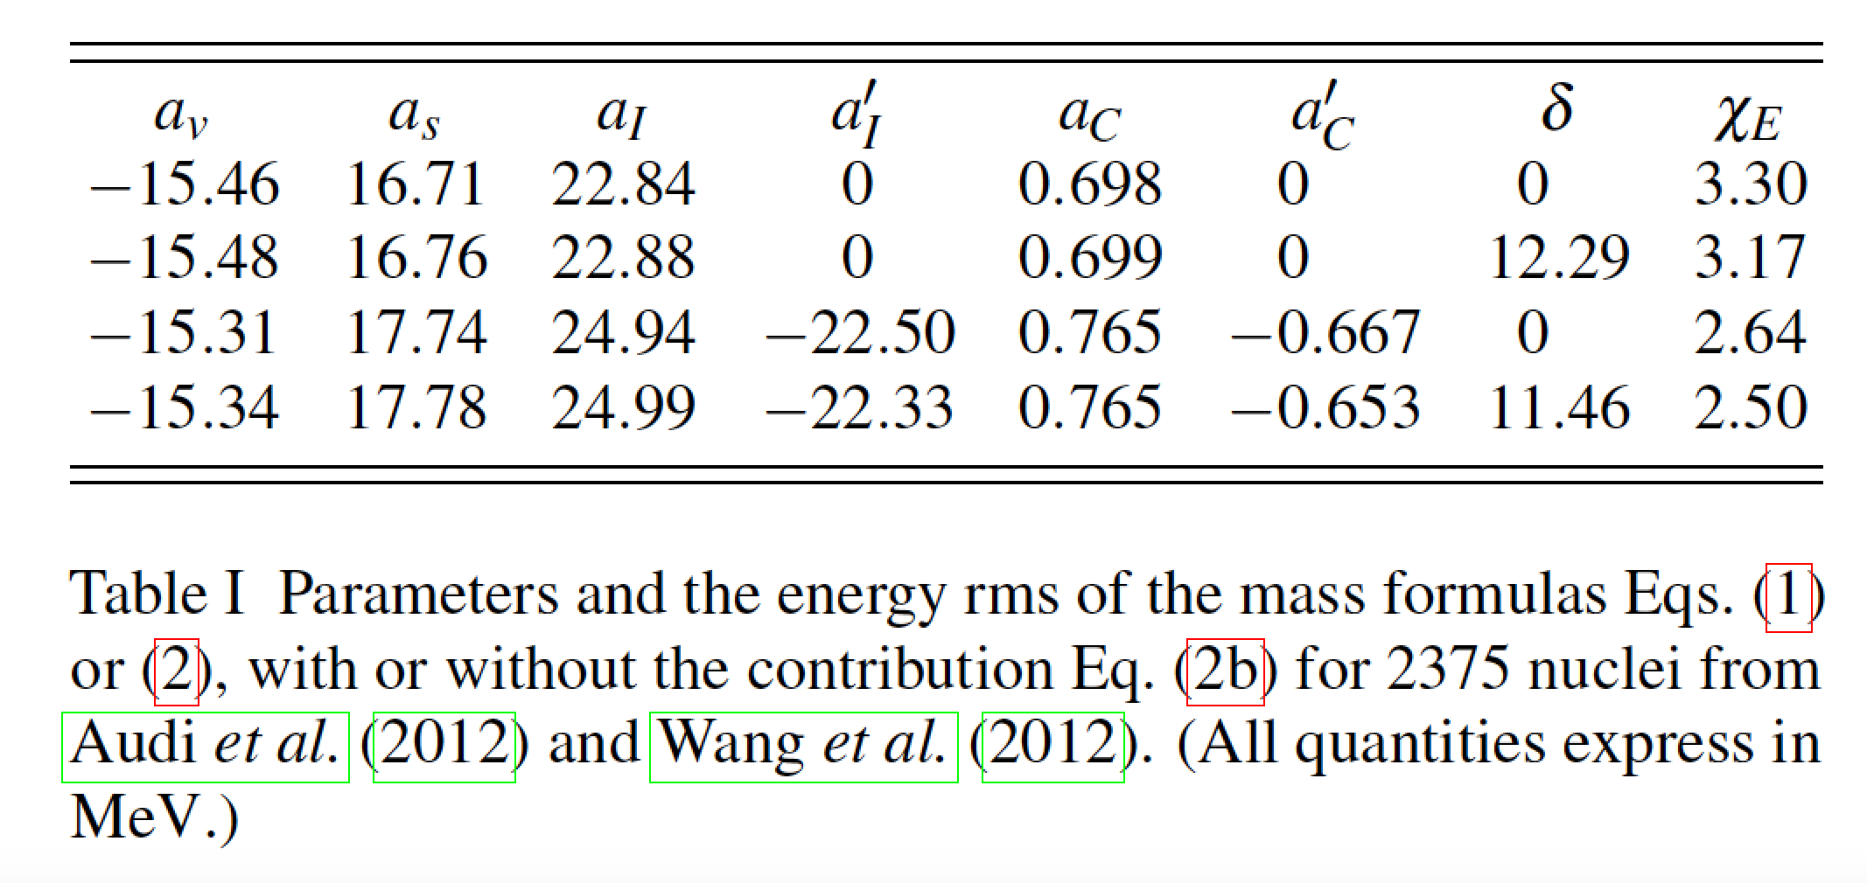


The most prominent formula in nuclear physics:
Bethe-Weizsäcker mass formula (1936)

Slide 3
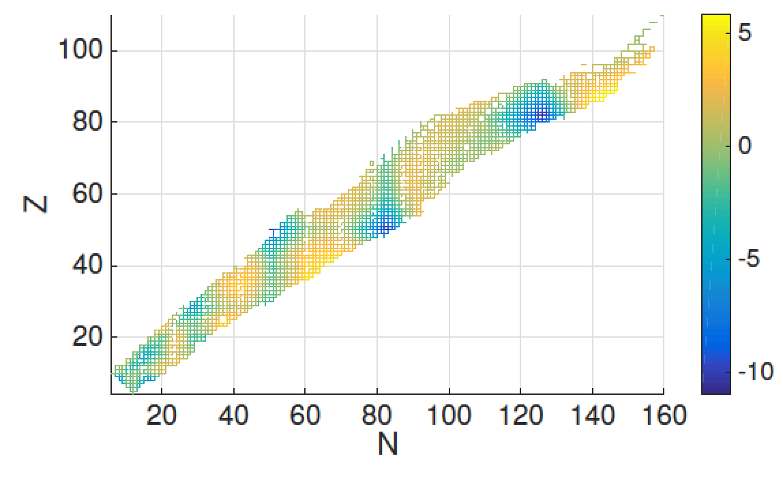

Slide 4
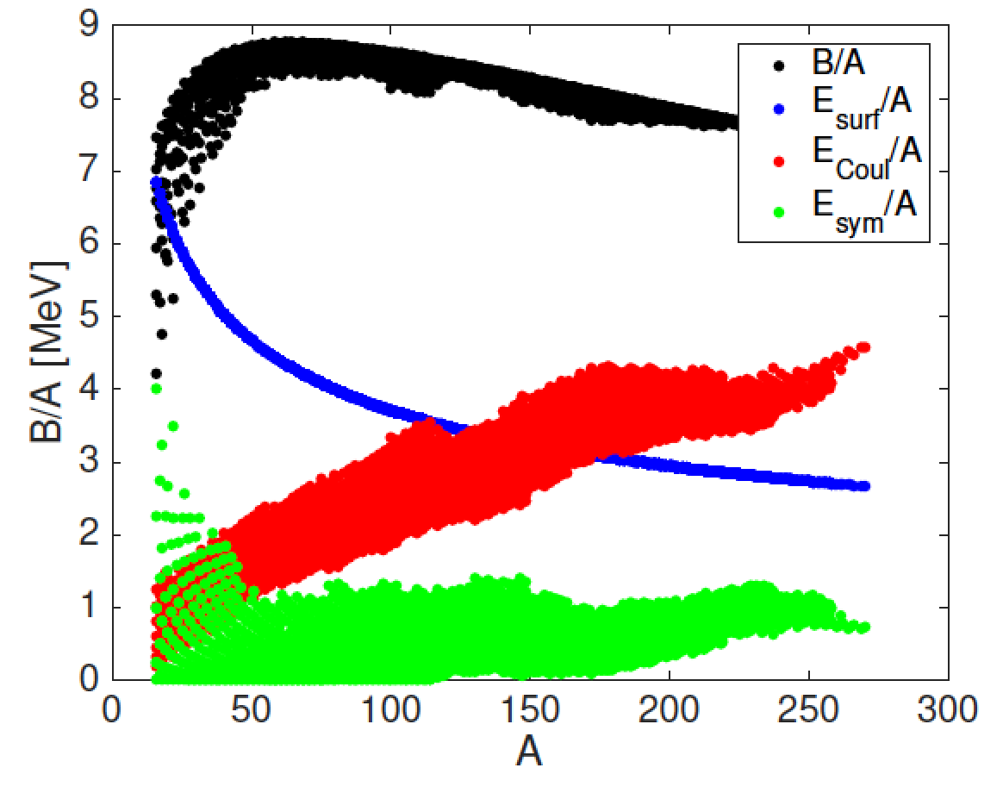

Slide 5


Single-particle density of states in a many-fermion system

Slide 6
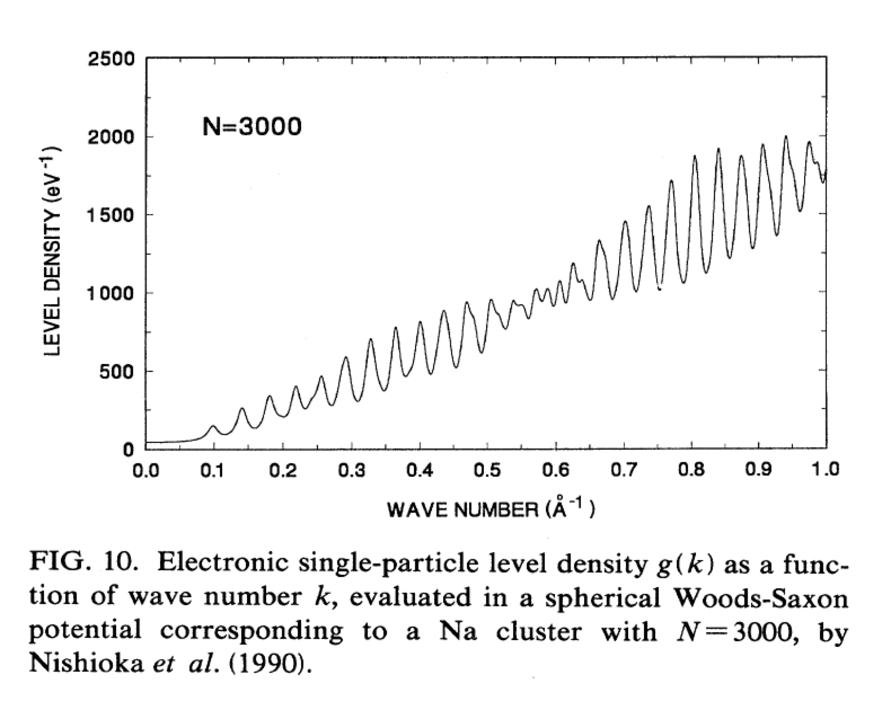

Slide 7
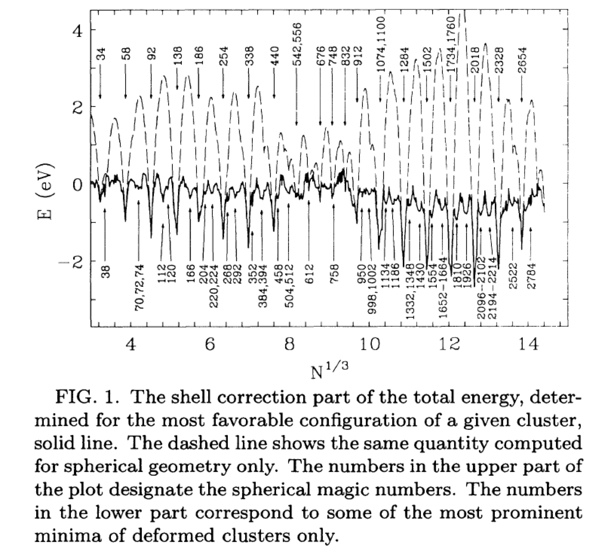

Slide 8
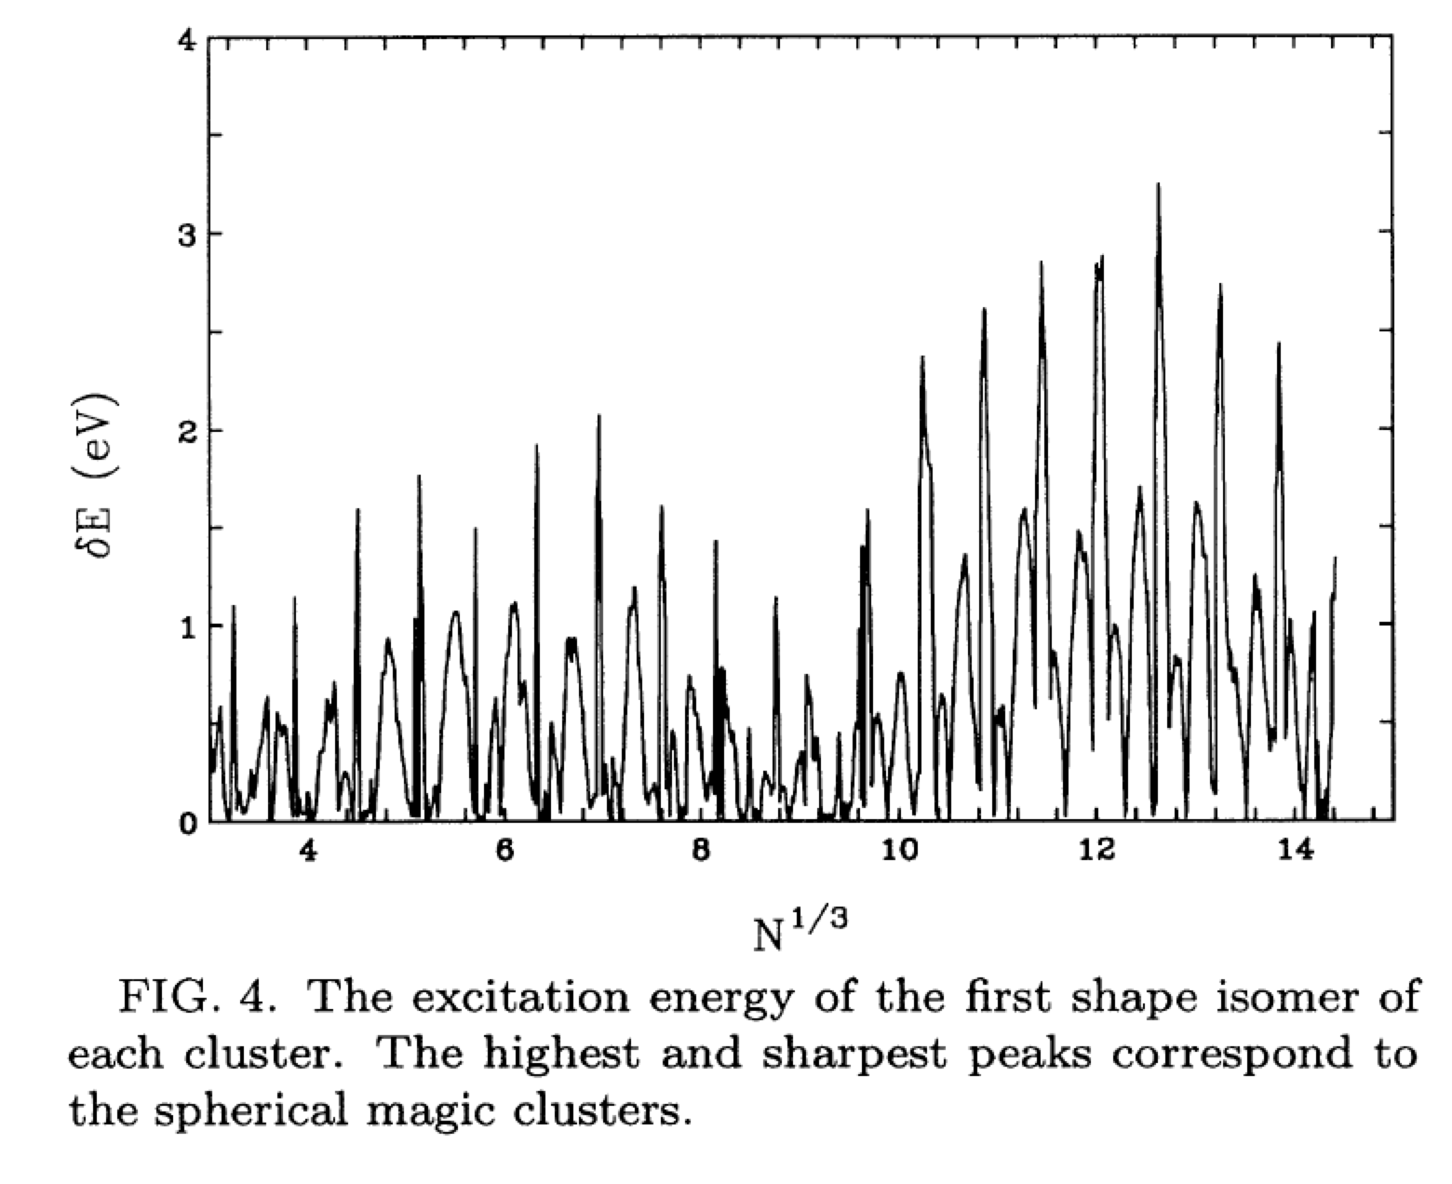

Slide 9
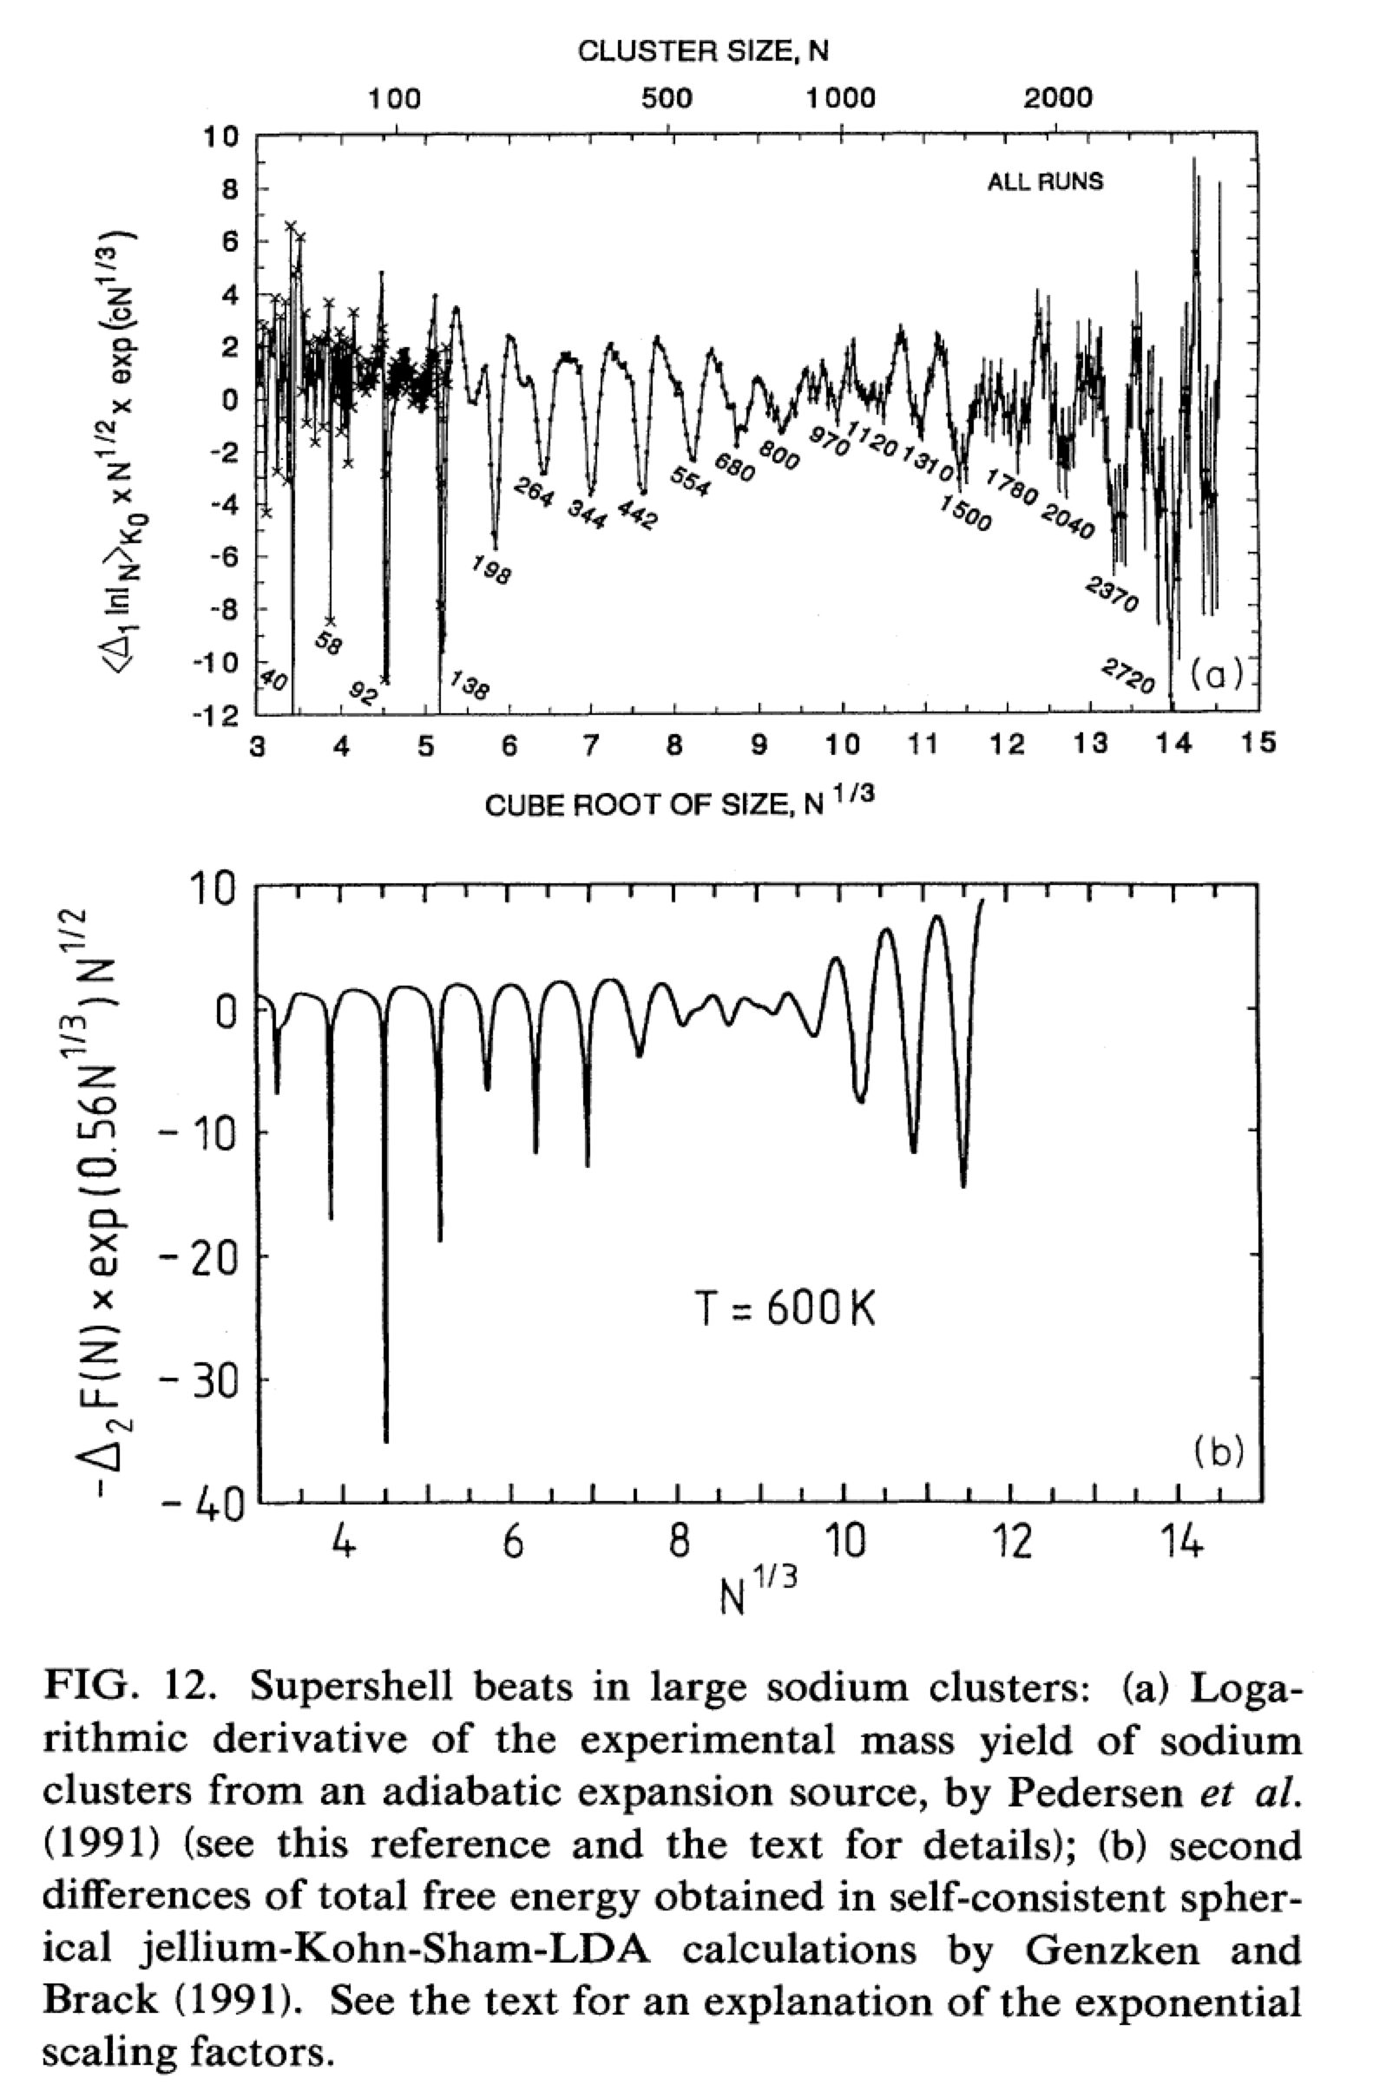

Slide 10




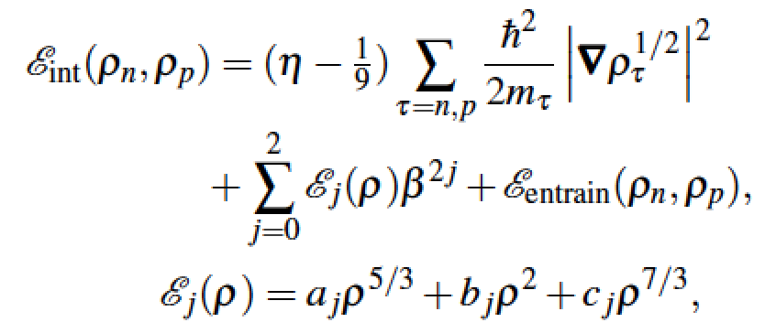


Slide 11
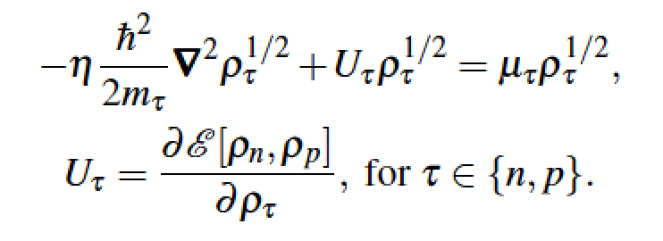

Slide 12

Higher order gradient corrections

Slide 13
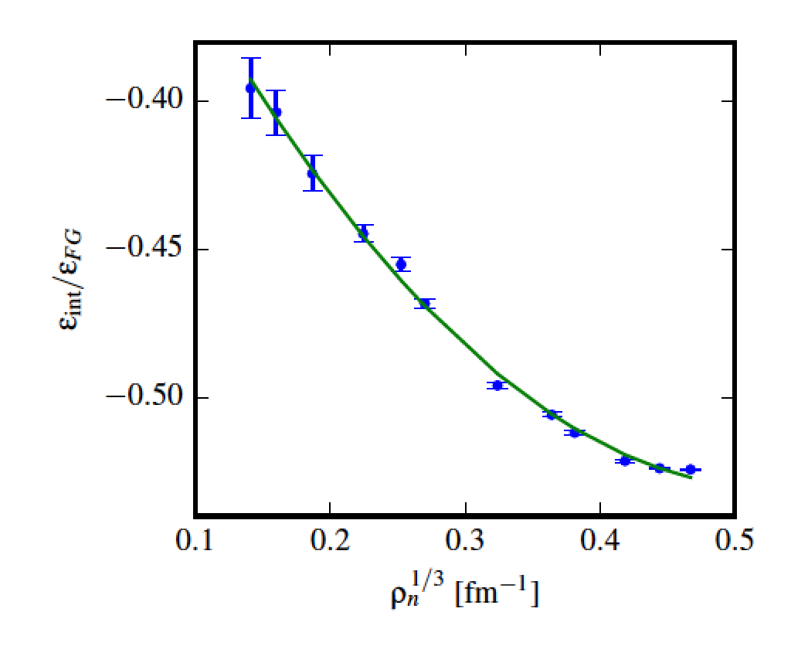
QMC of Neutron Matter EoS

Slide 14
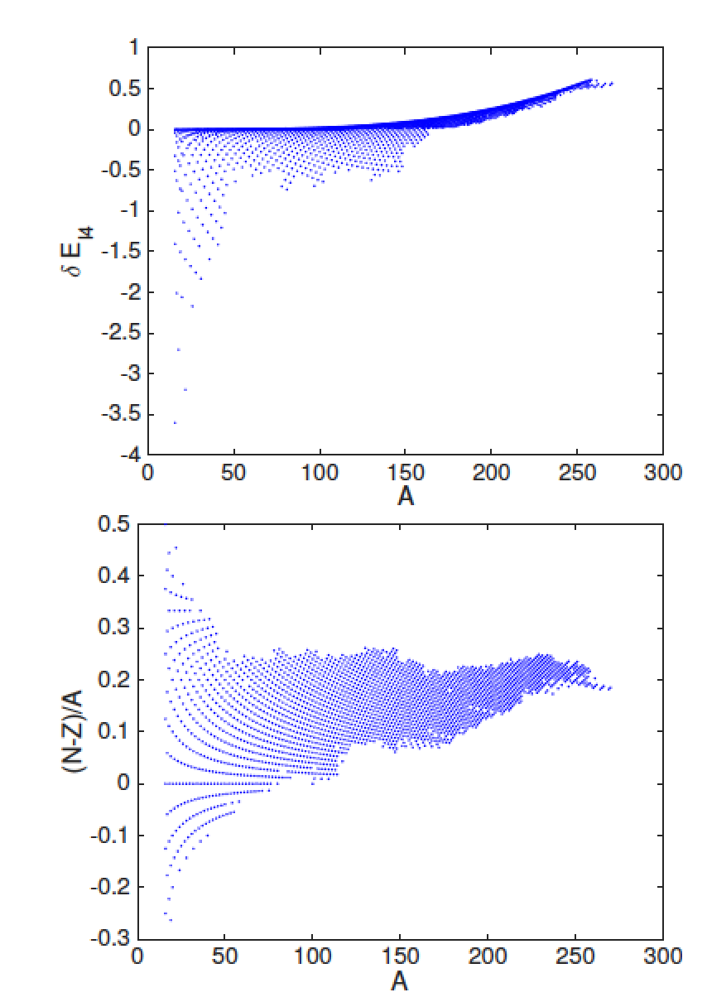

Slide 15
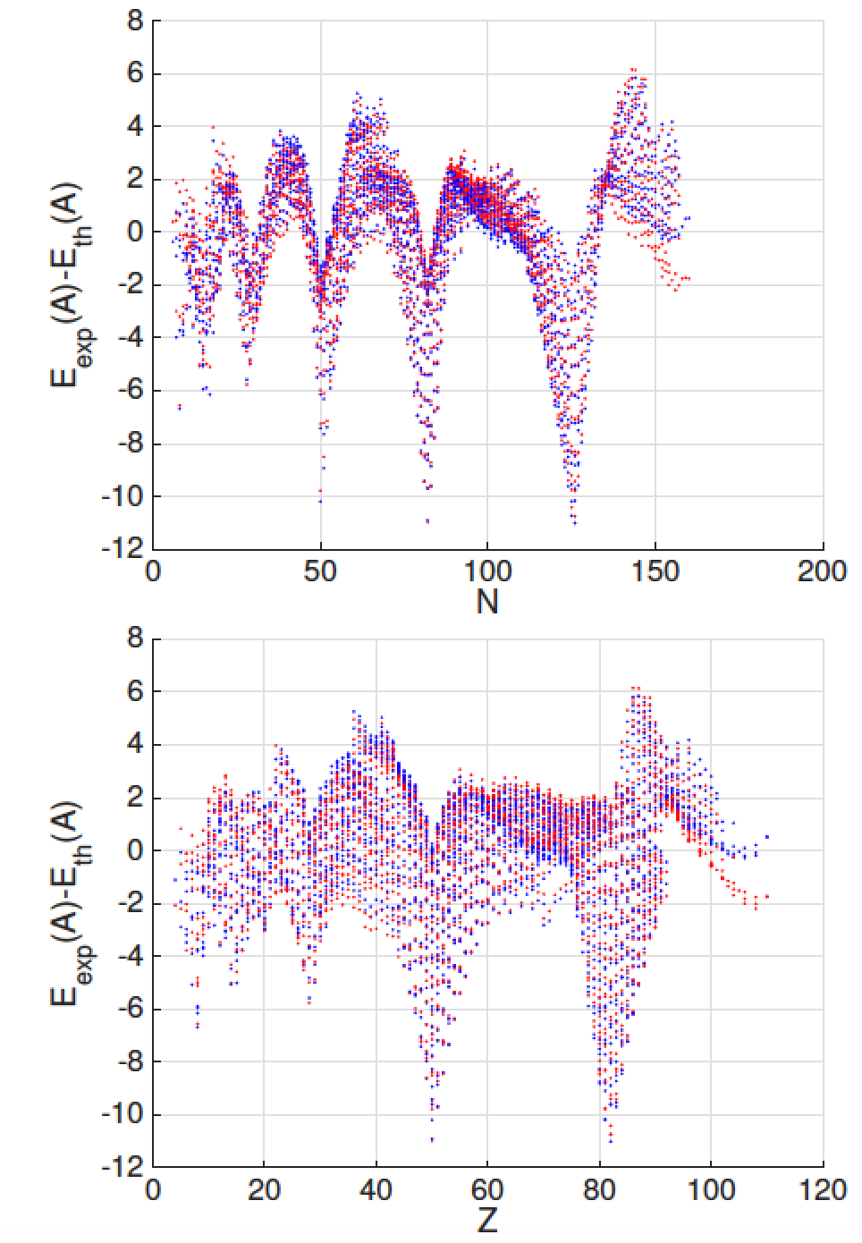
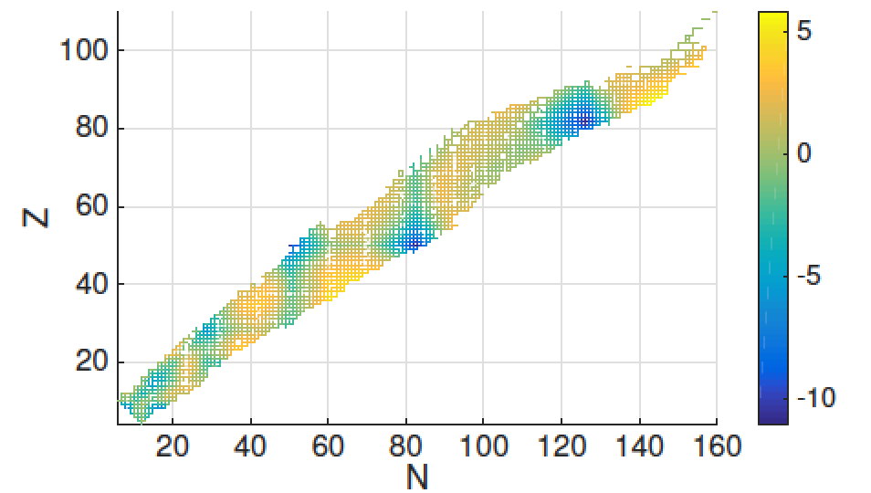

Slide 16
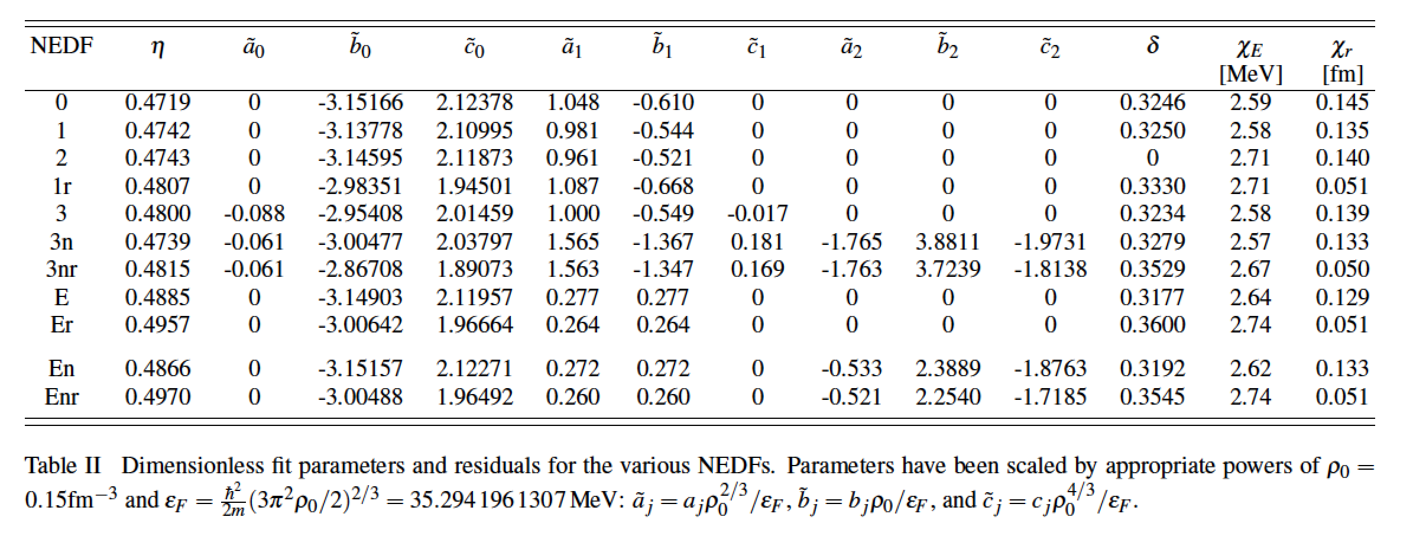
2375 nuclei (AME 2012) and 883 charge radii

Slide 17
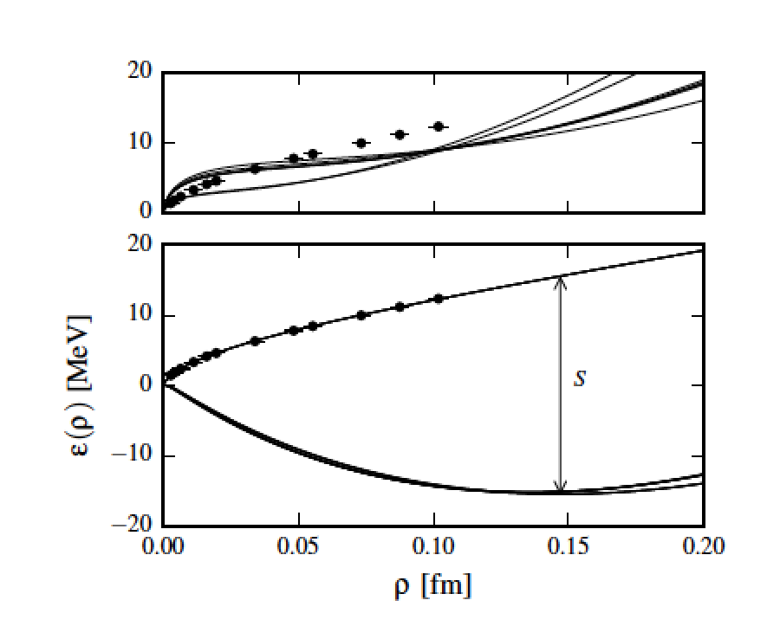

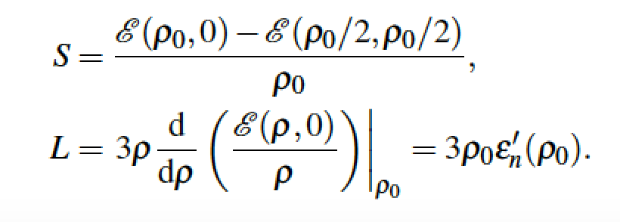


Slide 18


Slide 19
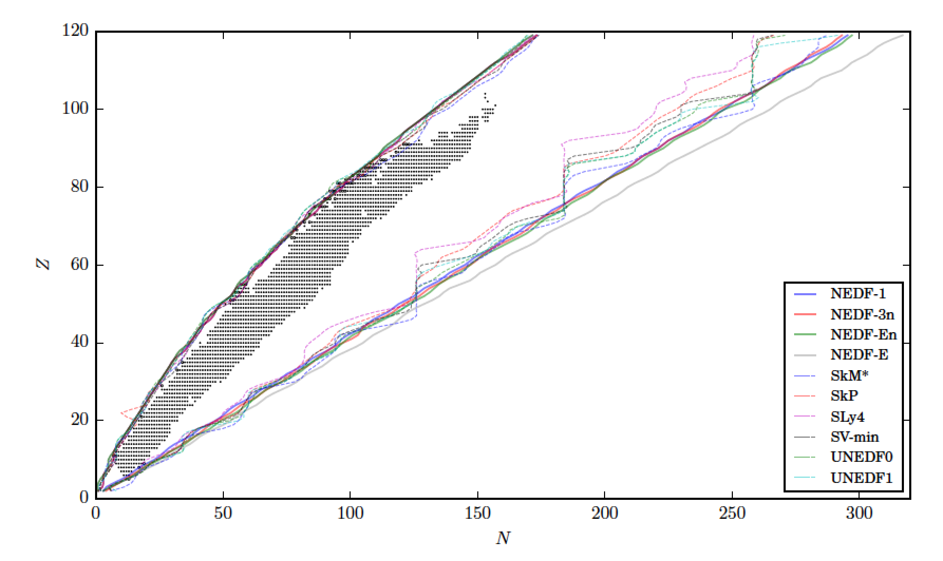

Slide 20
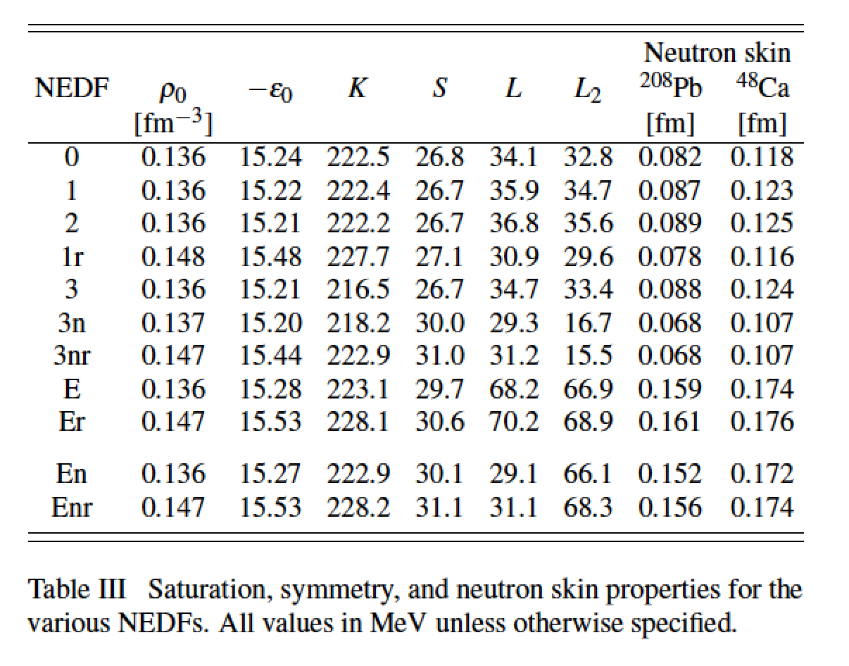

Slide 21
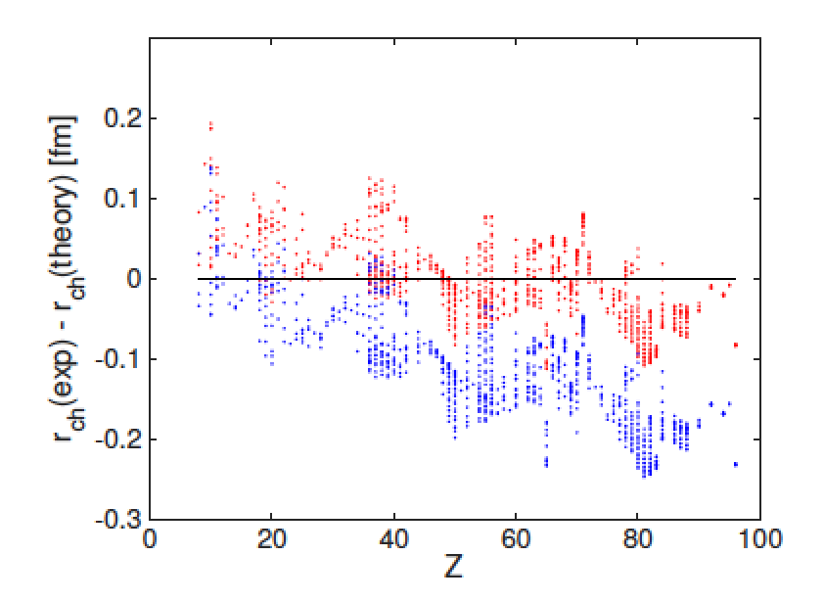

Slide 22
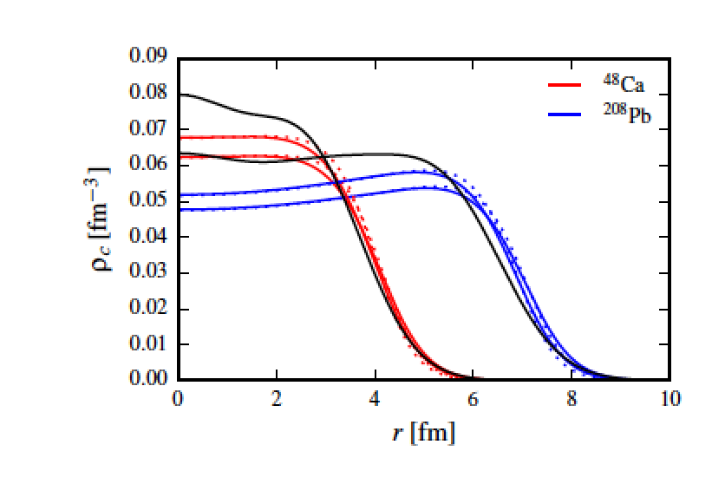

Slide 23
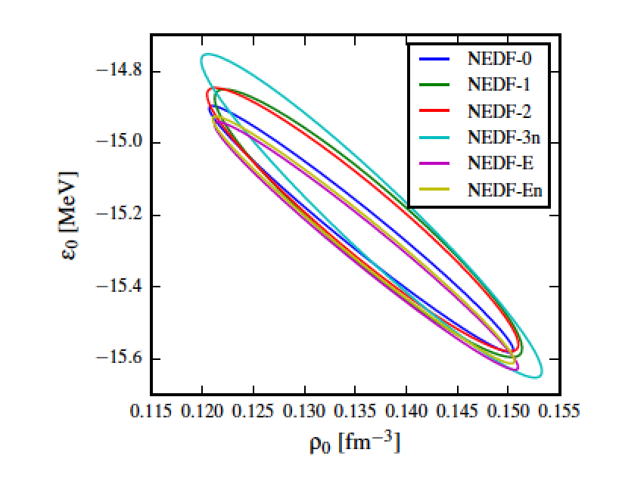

Slide 24
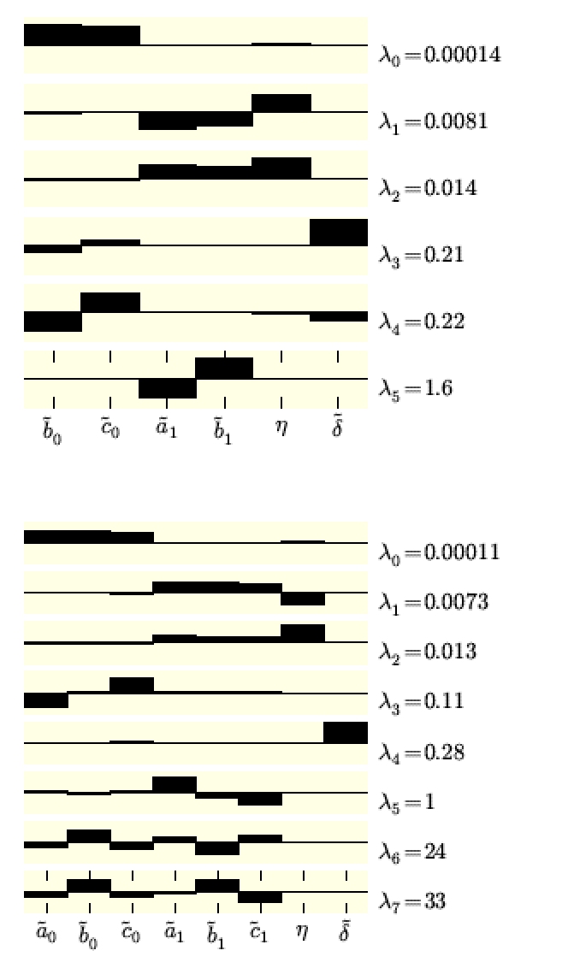





Slide 25




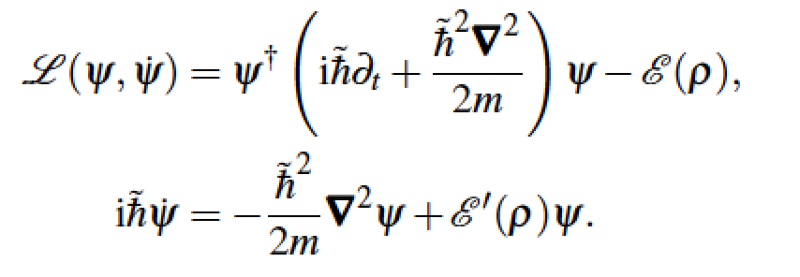

Dynamics

Slide 26


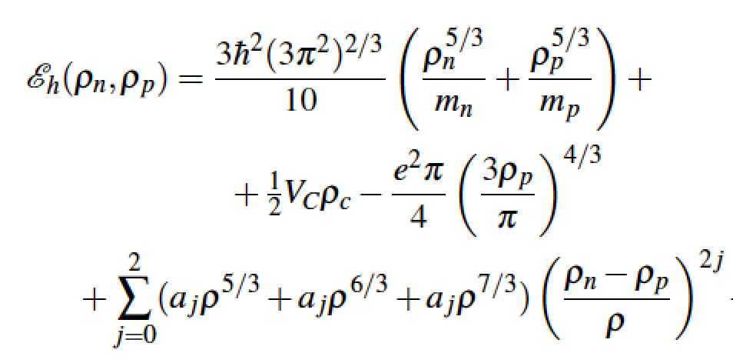
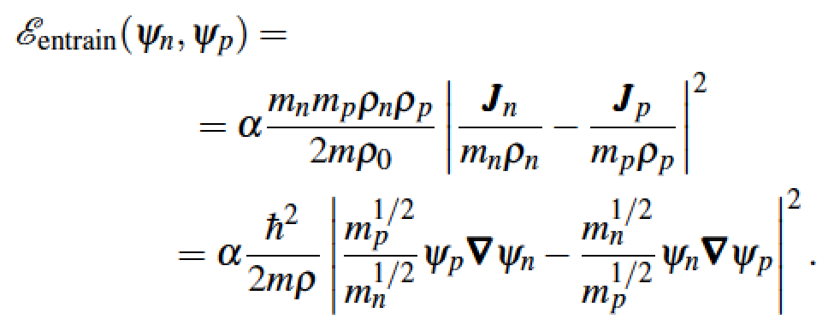


Slide 27
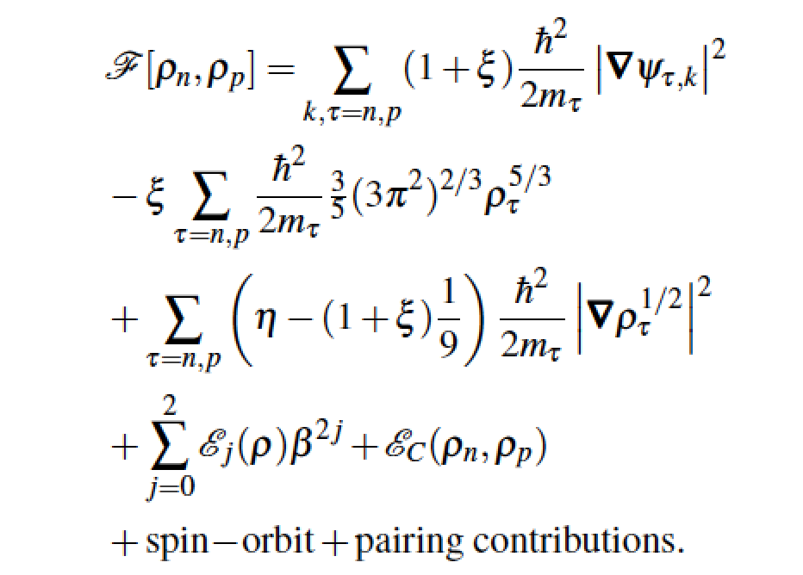

Introducing single-particle wave functions

Slide 28




Isovector excited collective modes

Slide 29
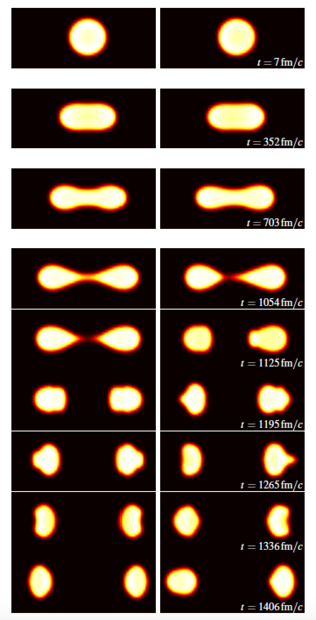
Fission

Slide 30
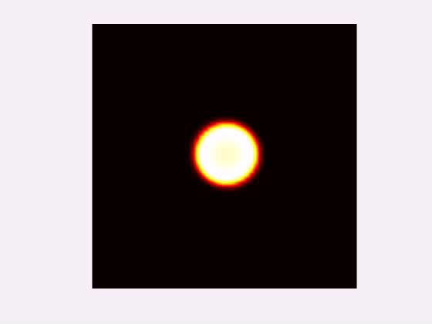
²³⁸U symmetric fission

Slide 31

²³⁸U asymmetric fission

Slide 32
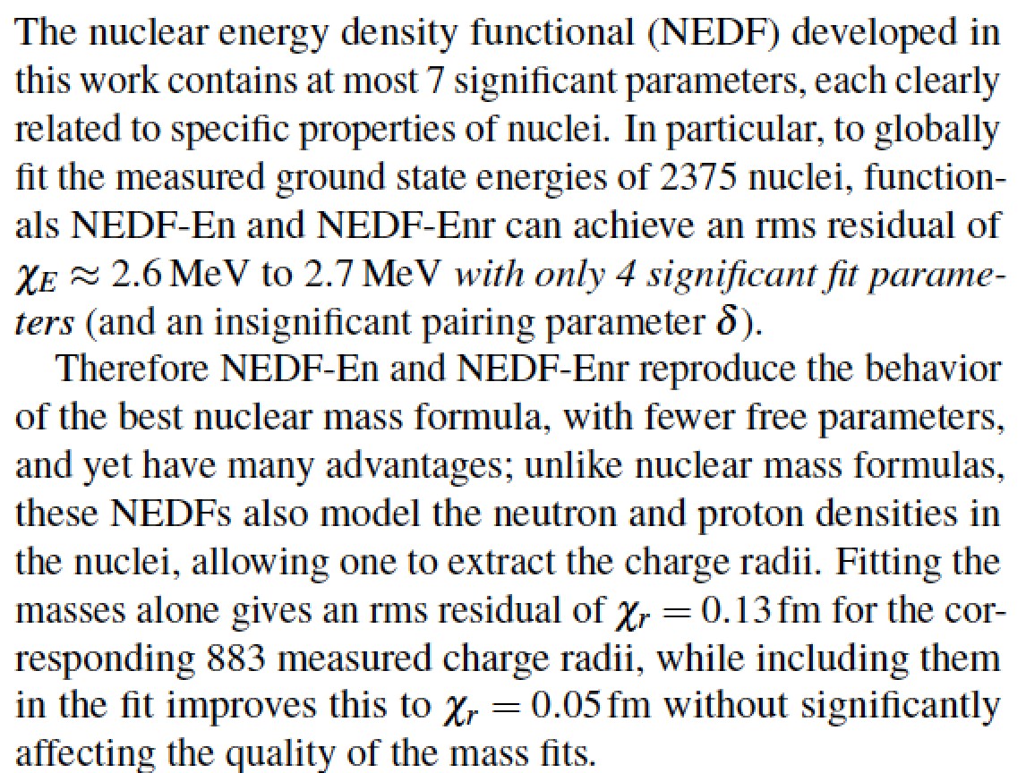

Slide 33
